Slide 1
2026 Bi-Weekly BIA Call
March 17, 2026
Zoom Meeting link:
https://us06web.zoom.us/j/85045752826?pwd=jvsySSvZ4NbKQ6a2pPkmqXZU3gfler.1
Meeting ID: 850 4575 2826
Passcode: TABIA

Slide 2
Land Acknowledgement We acknowledge that the land we are meeting on is the traditional territory of many nations including the Mississaugas of the Credit, the Anishnabeg, the Chippewa, the Haudenosaunee and the Wendat peoples and is now home to many diverse First Nations, Inuit and Métis peoples. We also acknowledge that Toronto is covered by Treaty 13 signed with the Mississaugas of the Credit, and the Williams Treaties signed with multiple Mississaugas and Chippewa bands. African Ancestral Acknowledgement We also acknowledge all Treaty peoples – including those who came here as settlers – as migrants either in this generation or in generations past - and those of us who came here involuntarily, particularly those brought to these lands as a result of the Trans-Atlantic Slave Trade and Slavery. We pay tribute to those ancestors of African origin and descent.

Slide 3
TABIA BIA Meeting Protocol
Thank you for joining our bi-weekly call.
In-Person: Please use microphones or speak loudly and clearly for all to hear both online and in-person.
Should you have a question please raise your hand or indicate in the chat. Everyone will have a chance to speak and ask their question. Your patience is appreciated.
Please be respectful of others on the call and the different opinions that may be expressed.
BIA specific questions, unless beneficial to the group should be taken offline.

Slide 4
TABIA BIA Meeting Agenda
March 17, 2026
Announcements (8)
Guest 1: Mobile Amenities Initiative: Supporting Flexible Park Activation – Lauren Grosberg
Guest 2: Mobile Food & Beverage Offerings in Toronto Parks - Thomas Kakamousias
Guest 3: TPA 2026 On-Street Rate Changes – Pinremola and Anthony
Guest 4: Neighbourhood Guide for BIAs – Simon Wong
BIA Office Updates
Economic Development Updates
Dining District Grant Stream 1 – Tamara Kahsay
BIA Dressing Toolkit Update – Alex Bordokas
New Business

Slide 5
Announcements

Slide 6
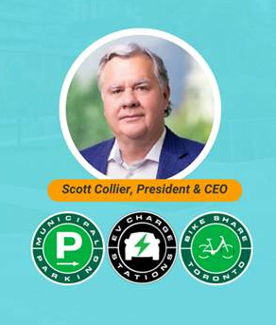
TABIA Breakfast with
Toronto Parking Authority President
Open to more than 2 attendees per BIA
Event Date: Tuesday, March 31st, at 7:30 a.m.
RSVP Deadline: March 23 at 12:00p.m.
RSVP here: https://TPA-Breakfast.eventbrite.ca

Slide 7
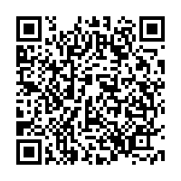
Toronto Festivals and Events Network Registration
As announced at the City Festivals and Events meeting on March 12, TABIA will be leading the establishment
of the association.
Register: https://zfrmz.ca/UZptzaQ6shTibZ29yXWu

Slide 8
Next BIA Masterclass
March 24 at 12-1pm
"Breakthrough Activations from Pop-Ups to the Everyday"
with Simon Wong, Queen Street West BIA
RSVP via calendar hold
In this hour, we will discuss how to breakthrough with activations from pop-up events to creative ideas of how a Business Improvement Area can drive visitors, traffic and build a neighbourhood while supporting economic development and the City.

Slide 9
Succession Matching Webinar
Assets available on TABIA website
Recording, Q&A, and enrolment link
https://www.toronto-bia.com/news-items/webinar-succession-planning/

Slide 10
City Street Furniture Survey –
Closes March 29, 2026
Complete survey here: https://ca.mar.medallia.com/StreetFurniture
20-year Astral Media agreement ends August 2027. Astral Media supply, manufacturing, installation and maintenance of approximately 25,000 street furniture elements, including transit shelters, litter bins, benches, postering structures, information pillars and automated public toilets. Help shape the future of Toronto’s street furniture. Open to the public – please share with your networks.

Slide 11
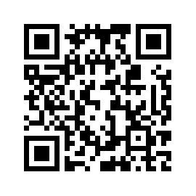
TABIA Paid Duty Officers (PDO) Survey
Tell us about your experience with Toronto Police Services (TPS) Paid Duty Officers (PDOs) for your BIA event(s). Complete by end of March 2026.
Complete survey here:
https://survey.toronto-bia.com/zs/dsD1dm

Slide 12
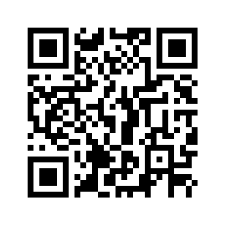
Snow Removal Logs
Please continue to log your snow removal issues
(date, location, issue) for the post-mortem on City snow removal services. Upload by end of March 2026
You may upload your logs here:
https://survey.toronto-bia.com/zs/4DD19Q

Slide 13
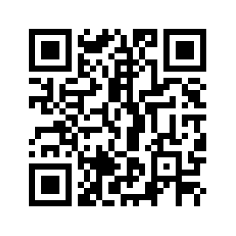
TABIA FIFA World Cup Events Survey
Inform TABIA of your events and activations during the World Cup, regardless of whether they are World Cup specific. These details will help us as we connect with stakeholders like Destination Toronto and others.
Complete survey here: https://survey.toronto-bia.com/zs/AWBspT

Slide 14
Guest 1: Mobile Amenities Initiative – Supporting Flexible Park Activation
Lauren Grosberg, Coordinator, Outreach & Special Projects, Policy & Strategic Planning, Parks & Recreation, Lauren.Grosberg@toronto.ca
An overview of the City’s proposed Mobile Amenities Initiative, which will provide shared moveable infrastructure (tables, chairs, umbrellas, games, etc.) to support programming and activation in pre-approved park locations. The session will highlight potential opportunities for BIAs and community groups to engage with this initiative and provide feedback.

Slide 15
Guest 2: Mobile Food & Beverage Offerings in Toronto Parks
Thomas Kakamousias, Manager Business Services – Parks & Recreation, Thomas.kakamousias@toronto.ca
This presentation will highlight current food and beverage services in City parks and outline opportunities to expand mobile vending based on operational and community feedback, followed by an open discussion to gather your input.

Slide 16
Guest 3: TPA 2026 On-Street
Rate Changes
Pinremola Olufemi, Senior Planner, Pinremola.Olufemi@greenpmobility.com
Anthony Johnson, Advisor, Stakeholder Engagement, Anthony.johnson@greenpmobility.com
On February 10, 2026, City Council directed the Toronto Parking Authority to implement on street rate increases in 2026 in order to align with the City’s mobility and financial objectives. Members of the Toronto Parking Authority are joining TABIA’s meeting to respond to any questions from BIAs regarding these changes in advance of implementation anticipated to commence in April 2026.
Map of On-Street Parking Changes (with BIA areas): 2026 On-Street Parking Rate Changes
Full list of On-Street Parking Changes: Attachment 2 - Parking

Slide 17
Guest 4: Neighbourhood Guide for BIAs
Simon Wong, Queen Street West BIA, simon.wong@queenstreetwest.ca
Working with TABIA and Visitor Economy Office to build a Neighbourhood Guide for BIAs that would be distributed in the INFOTOGO trailers during FIFA and TABIA Love Local booth at Billy Bishop.

Slide 18
BIA Office Updates
Kay Matthews, kay.matthews@toronto.ca
BIA Office, BIAoffice@toronto.ca

Slide 19
Economic Development Updates
Lesley Vaage, Economic Development, Lesley.Vaage@toronto.ca
Tamara Kahsay, CafeTO, Tamara.Kahsay@toronto.ca
CafeTO, CafeTO@toronto.ca
Lais Siqueira, Metrolinx Liaison, lais.siqueira@toronto.ca
City program leads provide updates on behalf of the team, including items such as public market reports, grant launches/deadlines, and relevant updates related to CafeTO and Metrolinx.

Slide 20
Dining District Stream 1 – March 25
Tamara Kahsay, Economic Development Officer, Tamara.Kahsay@toronto.ca
Formerly known as the CaféTO BIA Grant, this program has evolved to support Business Improvement Areas (BIAs) and eligible non-profit organizations in creating vibrant neighbourhood enhancements. The program aims to strengthen outdoor dining, enhance streetscapes, and support main street vitality.
Key Details
Open to BIAs and eligible non-profit organizations
Supports initiatives that enhance neighbourhood outdoor dining and public spaces
Applications open March 25 and close April 22
For more information about the program, please visit program webpage or contact diningdistrict@toronto.ca

Slide 21
BIA Dressing Toolkit Update
Alex Bordokas, Project Manager, Special Projects, Alexander.Bordokas@toronto.ca
For questions, email fwc2026toronto@toronto.ca
View the BIA Dressing Toolkit on the BIA Cloud under FIFA World Cup category
https://www.toronto-bia.com/bia-cloud/

Slide 22
New Business

Slide 23
Bi-Weekly BIA Meeting
March 31, 2026 from 3-4:30pm
https://us06web.zoom.us/j/85045752826?pwd=jvsySSvZ4NbKQ6a2pPkmqXZU3gfler.1
Meeting ID: 850 4575 2826
Passcode: TABIA

