Slide 1
Street Vending & Busking
Overview
City of Toronto Municipal Licensing & Standards
September 2025

Slide 2
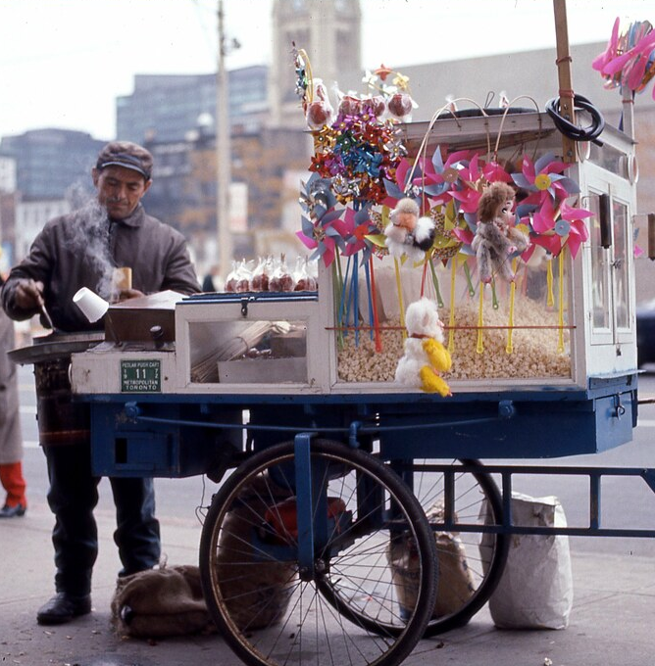
Background
Permits & Licences
In Toronto, all street vendors, street performers, hawkers and pedlars need a licence and/or a permit to operate, vend, or perform on streets and sidewalks.
Vendors also need a licence to vend on private property. These licences and permits are regulated through three separate bylaws in The City of Toronto Municipal Code (Chapters 740, 545 and 313 – the “Street Vending Bylaws”).

Slide 3
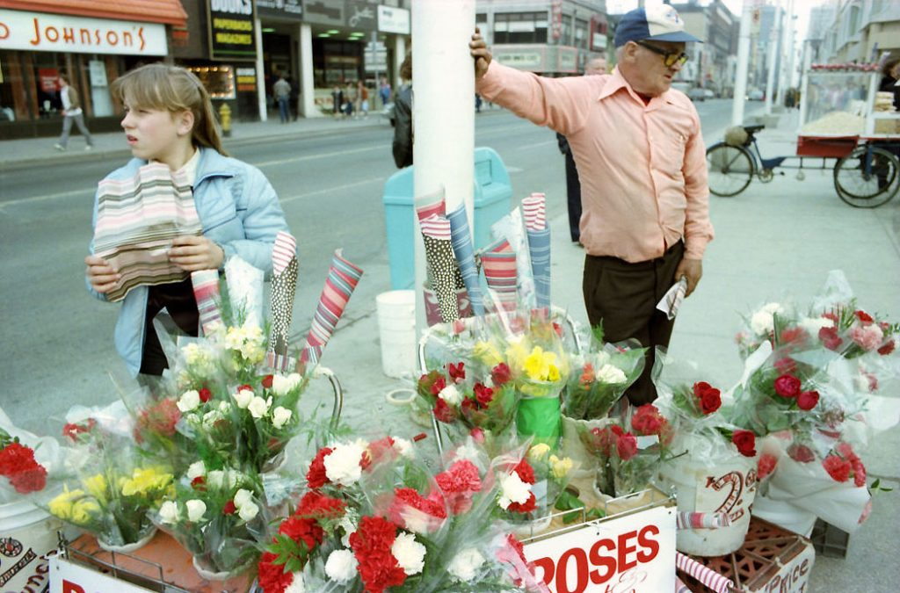
Background
Policy Review
Street Vending Bylaws have not been comprehensively reviewed since 2014.
The City is undertaking a review and update of the Bylaws to simplify, modernize and harmonize the rules, create better street vendor offerings, and address enforcement challenges.
Considering issues of noise, business competition, cleanliness, emissions, licensing fees, access to space, and overlap / conflicting information between the Bylaws.
A consultant, Barnes Management Group is leading external engagement

Slide 4
Bylaws under this review cover...
Food trucks
Buskers (performances e.g. mimes, jugglers)
Sidewalk vendors (e.g. hot dog stands)
Sales from cargo bikes
Ice cream trucks
Street musicians
Sidewalk merch sellers
Balloon salespeople
Fruit / vegetable vendors
Sidewalk and portrait artists
Caricature artists
Door-to-door salespeople

Slide 5
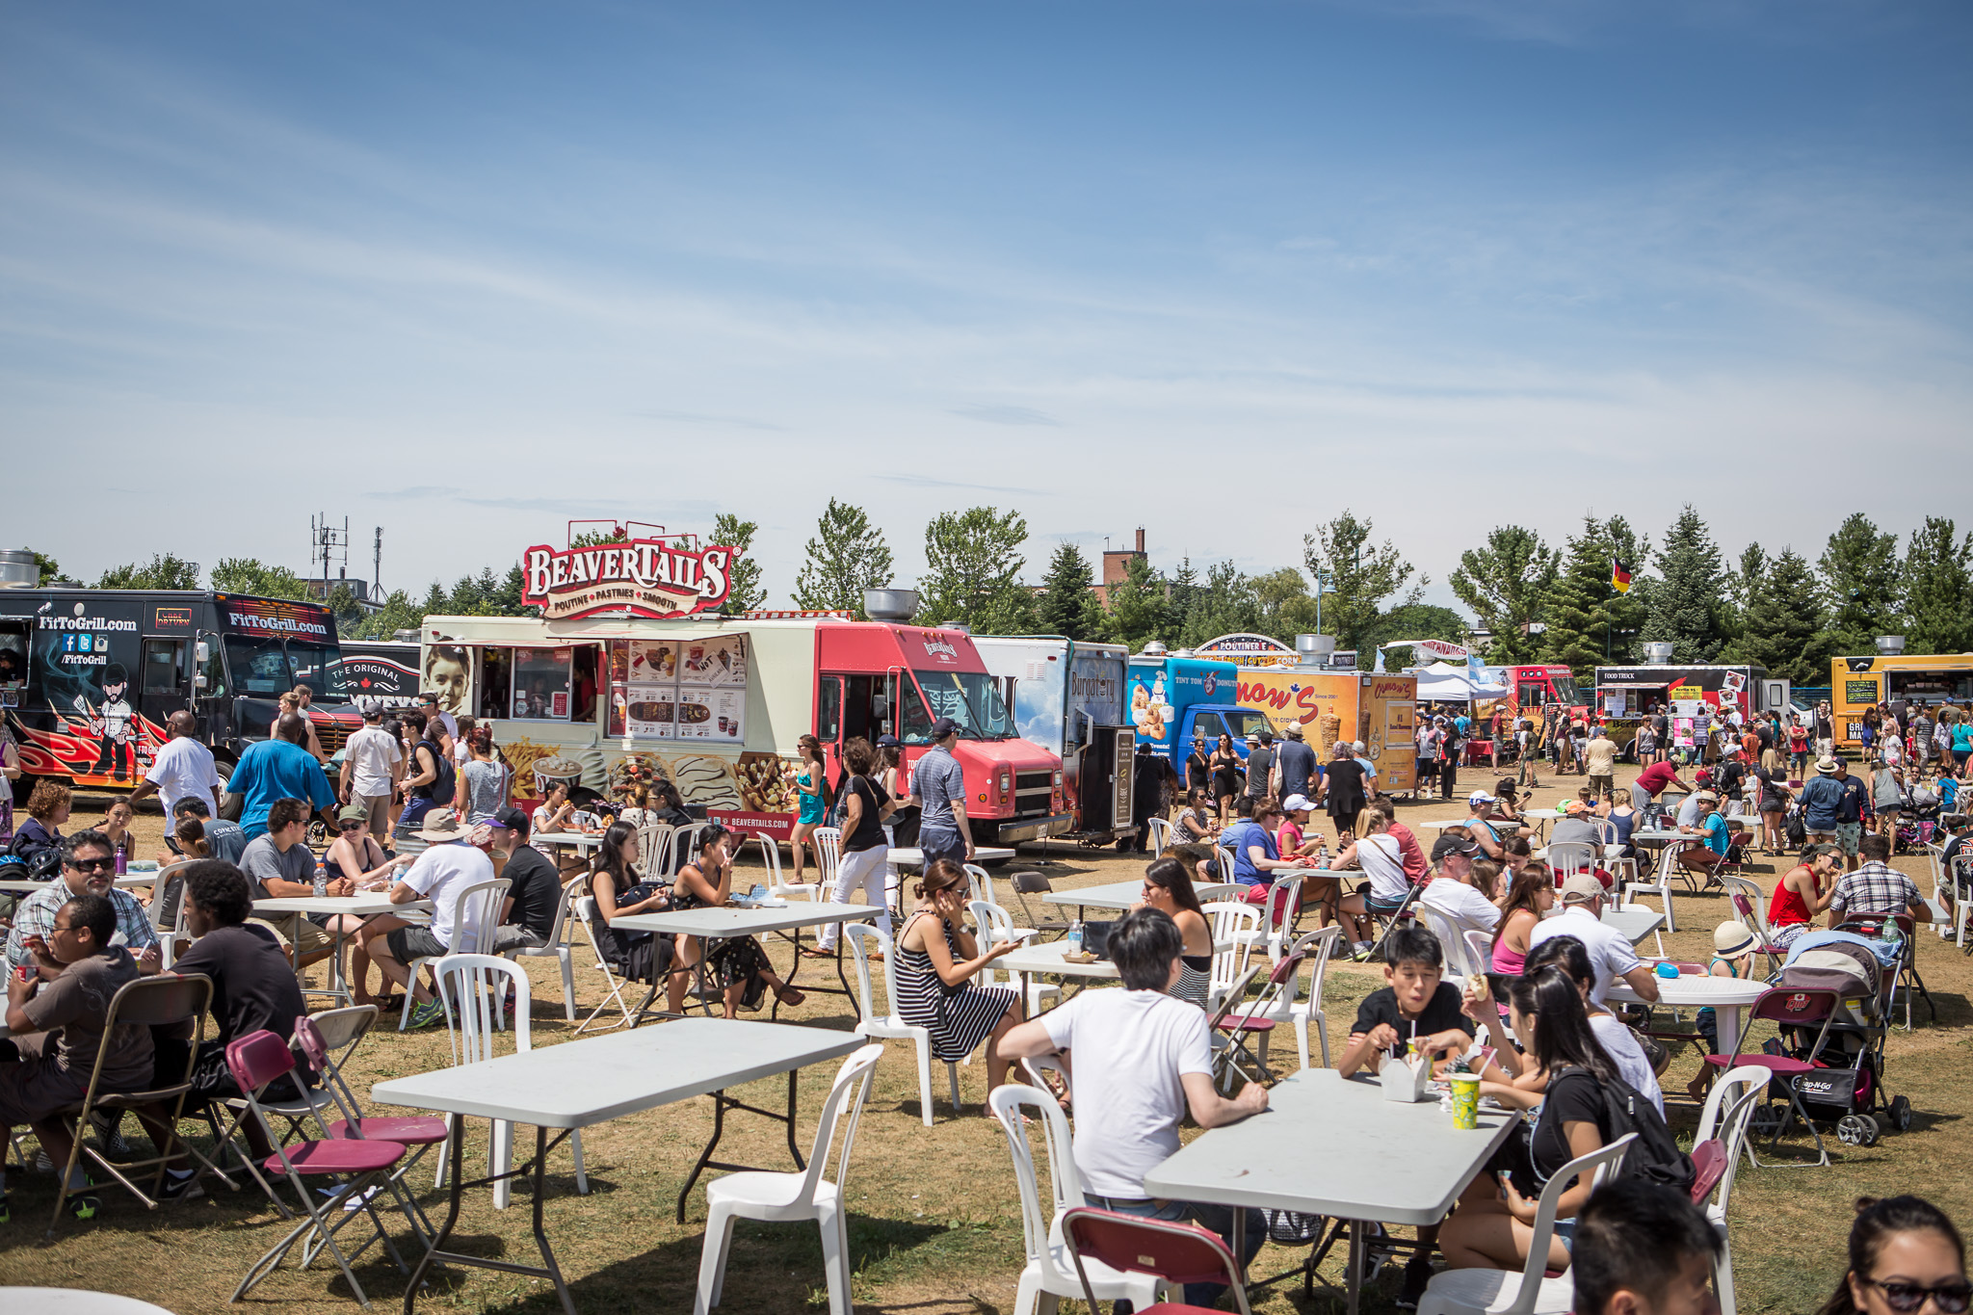
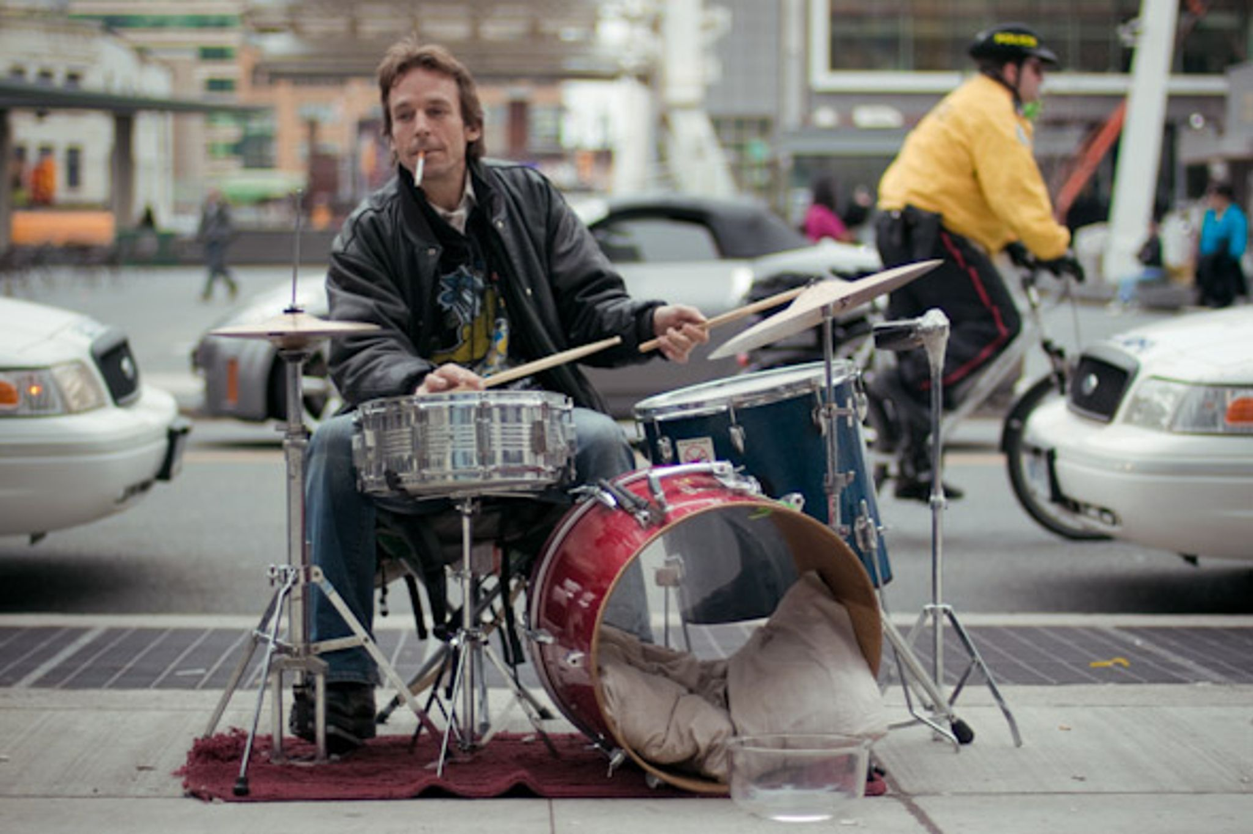
Who are we consulting?
Key Contributors
Vendors
Buskers & Performers
Residents, Commuters, Visitors
Other Contributors and Interested Parties
Food truck association of Canada
FIFA
Other City of Toronto divisions
Institutions (UofT, MTU)
BIAs & businesses

Slide 6
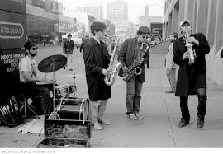
We want to hear from you
Tell us about your experience
As we review the City of Toronto’s street vending and performing bylaws, we want to hear from the people who it affects most
Through these discussion groups and our online survey, we want to understand concerns, issues, feedback and suggestions.
We want to know what’s working, what isn’t working, and how we can improve vending and busking in Toronto

Slide 7
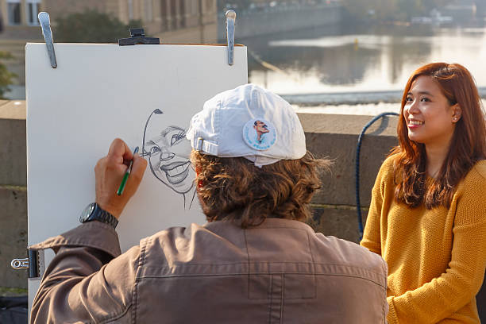
Engagement Opportunities
Check out www.Toronto.ca/StreetVending
BIA Focus Groups on September 3rd and 4th:
  Sep 3rd: 6:00PM on Zoom
  Sep 4th: 10:00AM on Zoom
We have a live survey open till September 30th, 2025
You can always e-mail us at streetvendingreview@toronto.ca

Slide 8
Next Steps
Jul – Aug 2025
Sep 2025
Dec 2025
Discussion & Focus Groups
Consultation with interested parties
Survey Open till September 30th
BIA Focus Groups
Public Meetings:
    September 10th & 22nd
Survey close Sept. 30th
Street Vending Report presented at Committee and Council

Slide 9
StreetVendingReview@toronto.ca
Toronto.ca/streetvending

