Slide 1

2025 TABIA Insurance Program

Slide 2
DISCLAIMER
The following presentation is only intended as a brief and non-binding summary of the policy. It does not outline all of the conditions and exclusions in your policy. Your actual insurance policy is more detailed and should be reviewed to better understand the coverages in place. If you have any specific questions about a potential or ongoing claim, please contact me at arian.ebrahimi@kaseinsurance.com

Slide 3
Coverage Summary
A - Insured Person Non-Indemnifiable Liability – Aggregate Limit of Liability
B – Insured Person Indemnifiable Liability: Aggregate Limit of Liability
C – Insured Organization Liability: Aggregate Limit of Liability
Employment Practices Wrongful Act: Aggregate Limit of Liability
Fiduciary Wrongful Act: Aggregate Limit of Liability
$10M Aggregate limit for entire policy

Slide 4
A - Insured Person Non-Indemnifiable Liability – Aggregate Limit of Liability
The Insurer agrees to pay on behalf of the insured person all Loss for which the insured person are not indemnified by the insured organization and shall become legally obligated to pay on account of a claim first made against them during the policy period because of the wrongful act.
“The company can’t help me, so the insurance pays me directly”

Slide 5
B – Insured Person Indemnifiable Liability: Aggregate Limit of Liability
The Insurer agrees to pay on behalf of the insured organization all loss which the insured person shall become legally obligated to pay on account of a claim first made against them during the policy period because of a wrongful act and for which the insured organization provided indemnification.
“The company helped me, now insured pays the company back”

Slide 6
C – Insured Organization Liability: Aggregate Limit of Liability
The insurer agrees to pay on behalf of the insured organization all loss for which the insured organization shall become legally obligated to pay on account of a claim first made against them during the policy period because of a wrongful act.
“The Company is being sued, and insurance covers it directly”

Slide 7
Coverage | Who's Sued | Who Pays Initially | Who Gets Paid by Insurance | When Used
A | Individual | No one (company can’t help) | The individual | Company can’t indemnify
B | Individual | The company | The company | Company does indemnify
C | Company | The company | The company | Company itself is sued

Slide 8
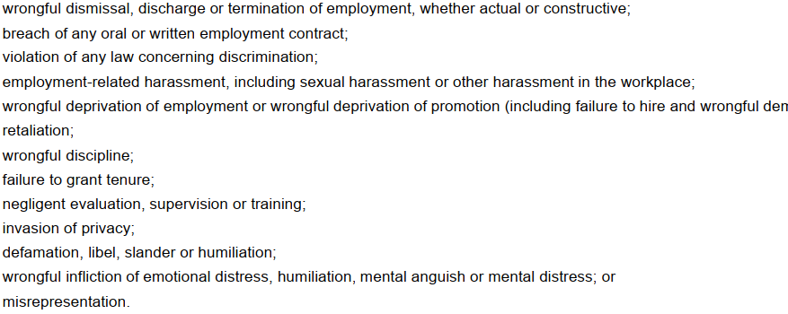
Employment Practices Wrongful Act: Aggregate Limit of Liability
Means any of the following acts related to employment or the application of employment:

Slide 9
Fiduciary Wrongful Act: Aggregate Limit of Liability
Means any error, omission, negligence or misleading statement actually or allegedly committed by the insured while engaged in the discharge of his duties:

