Slide 1

DOING BUSINESS WITH
THE CITY OF TORONTO
Purchasing and Materials
Management Division

Slide 2
Doing Business with the City of Toronto workshops take place on
the second Wednesday of each month from 9:30 am to 12 pm.
Upcoming Sessions
June 10th, 2025
Space is limited and registration is required.
To register, please contact: supplychain@toronto.ca or 416-397-4141.

Slide 3
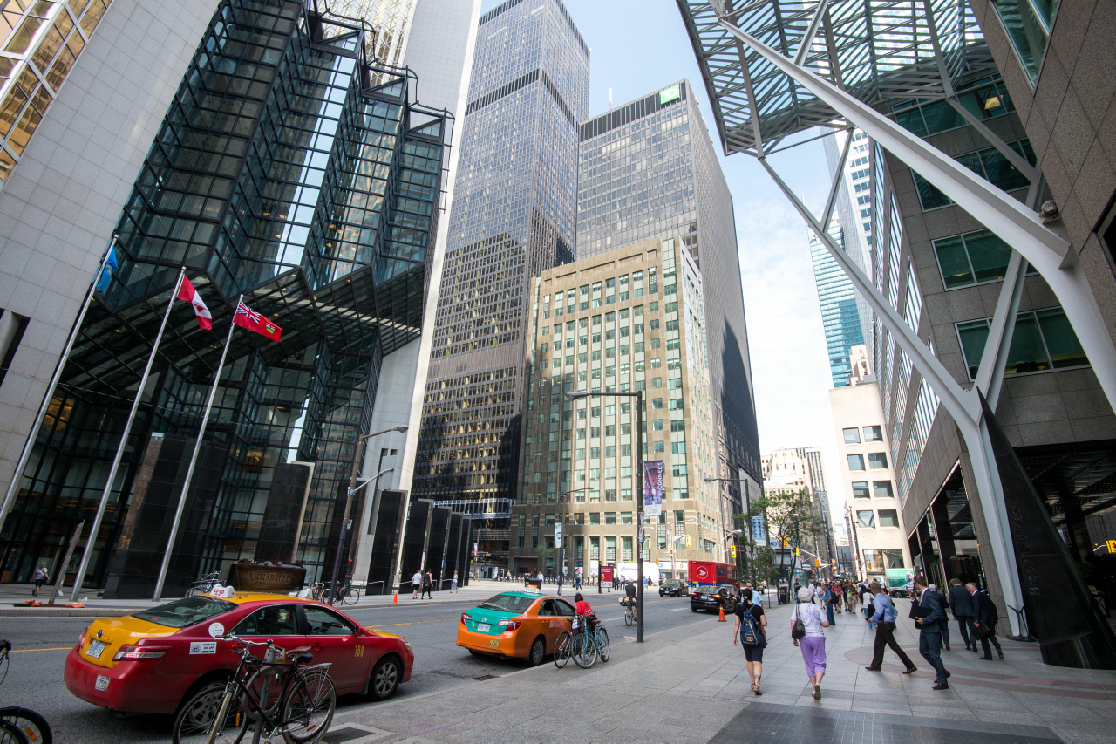
The City of Toronto
procures over
$2.5 Billion
in goods and services annually.

Slide 4
Types of Procurement
55% Construction Services
Asphalt Paving - Building Renovations – Demolitions - Heating, Ventilation, and Air-Handling - Painting Services - etc.
30% Professional Services
Consulting Services - Drafting, Surveying and Engineering Equipment and Services –
Law Enforcement Supplies and Services - Printing and Binding - etc.
15% Goods and Services
Automobiles and Trucks - Electrical Supplies - Hardware and Tools - Office Furniture and
Supplies - Petroleum Products - etc.

Slide 5
The Procurement Process
Identify
Needs
Sourcing Requests
Issue Solicitations
Bids
Received
City Divisions determine the types of goods and services they require.
City Divisions prepare sourcing requests detailing their requirements.
PMMD issues competitive solicitations on the SAP Ariba Discovery Portal.
Bids are received, evaluated, and awarded.
City Divisions prepare a budget and get approval.
Sourcing requests are submitted to PMMD.
Suppliers can view solicitations and place a bid to the City of Toronto.

Slide 6
Solicitation Methods
Request for Tenders (RFT) for construction services whenever the Division has pre-determined the required scope of work.
Request for Quotations (RFQ) for goods and services (other than construction services) whenever the Division has pre-determined the required quantity and quality of the goods and services.
Request for Proposals (RFP) for goods and services of a unique or complex nature where all or part of the requirements cannot be precisely defined. The expectation is that suppliers propose solutions to arrive at the desired result. The evaluation criteria to determine the best value may include more than price factors.
Invitational Solicitations ($50,000 to $133,800 in value) may be used to obtain goods and services (other than construction services) solicited through an email invitation with an Ariba link and are administered by the Purchasing and Materials Management Division.
  Invitational solicitations valued between $3000 to $133,800 may be administered directly by a Division as Divisional Purchase Orders (DPOs) and suppliers may receive an email invitation directly form City Staff.

Slide 7

SOCIAL PROCUREMENT
SUPPLY CHAIN DIVERSITY
WORKFORCE DEVELOPMENT
Notes:
My primary role is to best support suppliers engaging with the Social Procurement Program

Slide 8
Social procurement leverages the City's purchasing power to achieve social, economic, and workforce development goals.
WHAT IS
SOCIAL PROCUREMENT?
Notes:
Social procurement is the practice of using the City of Toronto’s purchasing power to achieve social, economic, and workforce development goals. The Social Procurement Program uses a variety of tools to leverage social impact through City contracts.
In May 2016, Toronto City Council adopted the City of Toronto’s Social Procurement Policy as a tangible approach to driving inclusive economic growth.
There are two key components of the Social Procurement Program.

Slide 9

Social Procurement – Supply Chain Diversity
Goal 1:
Goal 2:
Diversify the City’s supply chain by contracting and subcontracting to Indigenous, Black, and Diverse Suppliers and Social Purpose Enterprise.
Notes:
The first component is supply chain diversity, where we aim to increase access to City contracts for certified diverse suppliers.

Slide 10
Definitions:
Indigenous, Black or Diverse Supplier: An Indigenous, Black or Diverse Supplier is any business or enterprise that is a member of an Identity- Based Business Organization that is recognized by the City or is certified by a Supplier Certification Organization to be more then 51% (majority) owned, managed and controlled by persons belonging to an Indigenous, Black or Equity-deserving community.
A “Social Purpose Enterprise” is a business that generates a significant portion of its revenue through the sale of goods or services, embeds a social, cultural or environmental purpose into the business, and reinvests 51% or more of profits into the social, culture or environmental mission.
A “Identity-Based Organization” is a membership-based non-profit or charitable organization recognized by the City with a mission to support Indigenous, Black and Diverse Suppliers.
Notes:
In the City’s Social Procurement Program, Diverse Suppliers are any business or enterprise that is certified by a Supplier Certification Organization to be:
Majority (that is to say 51% or more) owned, managed, and controlled by persons belonging to an equity-deserving community, or
A “Social Purpose Enterprise” which is an enterprise whose primary purpose is to create social, environmental, or cultural value and impact, and where 51% or more of the full-time equivalent employees are participating in, or have completed transitional employment training, and experience economic disadvantage.

Slide 11
Definitions: Indigenous People and Equity-Deserving Community
      “Indigenous People” is a term used internationally to collectively represent the original inhabitants or those naturally existing in a particular place. In this context, “Indigenous” is used to refer to the First Nations, Métis and Inuit People.
      “Equity-Deserving Communities” Communities that face significant collective challenges in participating in society because of institutional and societal barriers to equal access, opportunities and resources due to disadvantage and discrimination. Members of an Equity-deserving community may include, but are not limited to: women, racialized communities, newcomers/recent immigrants, persons with a disability including mental health, 2SLGBTQ+ communities, Equity-Deserving Youth, veterans and persons with low income.
Notes:
These definitions are available for you on our website.

Slide 12
Social Procurement Policy – Supply Chain Diversity
For Divisional Purchase Orders and invitational solicitations, valued between $3,000 and $133,800, a minimum of one Black, one Indigenous and one Diverse Supplier/social purpose enterprise must be invited to bid, where feasible, as part of the three-quote process.
For RFPs over $133,800K, up to three points shall be awarded to the proponent profile for suppliers who commit to developing a supplier diversity policy within their organization, or provide evidence of their diverse supplier certification.
For RFQ’s and Tenders, tied bids will be awarded to the certified Black, Indigenous os Diverse supplier. If both suppliers are certified diverse suppliers, then a coin toss or lottery shall be used to break the tie.
Notes:
We will go over how the Social Procurement Policy which aims to achieve diversity in the City’s supply chain by:
(1) Requiring, where feasible, a minimum of one black, one indigenous and one certified diverse supplier/social purpose enterprise to bid on Divisional Purchase Orders and invitational solicitations valued between $3,000 and $133,800 as part of the City’s three quote process.
(2) For Requests for Proposals over $133,800 in value, points will be given to proponents that are a certified diverse supplier or demonstrate a commitment to a supply chain or employee diversity policy within their organization.
3) For RFQ’s and Tenders, in the case of a tied bid, being a certified diverse supplier will be the tie breaker. If both suppliers are certified diverse suppliers, then a coin toss or lottery shall be used to break the tie.

Slide 13








How does the City validate Indigenous, Black and Diverse Supplier Status?
Certification
Indigenous, Black and Diverse Suppliers and Social Purpose Enterprises can obtain their certification or receive membership from the following seven certification councils and identity-based business organizations in Canada:
Notes:
You may be wondering “How does the City validate that a company is a Diverse Supplier?”
The answer is that The City of Toronto is a corporate member with supplier certification organizations and identity-based businesses organizations which aim to identify 51% or more owned, managed, and controlled businesses by Indigenous, Black and Diverse Suppliers. These supplier certification organizations are listed on the slide, and also available on our website in greater detail.
To be recognized by the City of Toronto as a Diverse Supplier, eligible businesses could obtain certification through one of these five certifying organizations.
It is important to note that this is not about preferential treatment. It is about removing inequitable barriers to access and supporting a truly competitive climate.

Slide 14

Social Procurement – Workforce Development
Goal 2:
Goal 2:
Increase the number of employment, apprenticeship and training opportunities leveraged for people experiencing economic disadvantage, including those from equity-deserving communities.
Notes:
The second component of social procurement is workforce development.
Workforce development leverages City contracts to create training, apprenticeship, and employment opportunities for Toronto residents experiencing economic disadvantage due to discrimination and barriers.

Slide 15
Workforce Development Project Selection
Projects may be selected to include workforce development if:
The contract value exceeds $5M (including option years)
The project exceeds two years in duration
There is potential to create meaningful employment and skills development opportunities
Notes:
Not all City projects include workforce development.
We only select projects which are valued over $5M (including option years) which are more than two years in duration, and have the potential to create meaningful training and employment opportunities for Indigenous People or people belonging to Equity-deserving communities.

Slide 16

Workforce Development Activities
If selected, workforce development activities include:
Matching qualified candidates from equity-deserving communities with new jobs and apprenticeship opportunities created through City contracts
Subcontracting opportunities for certified Indigenous, Black and Diverse suppliers
Notes:
Workforce Development activities include:
Matching qualified candidates from equity-deserving communities with new jobs and apprenticeship opportunities created through City contracts
Training, Work-based Learning and Skills Development
Use of Diverse Suppliers in the Supply Chain
Other Employment-Related Activities (job fairs, mentorship and other workshops)

Slide 17
For questions about the procurement process and registering in SAP Ariba, contact supplychain@toronto.ca.
For more information on the Social Procurement Program, contact socialprocurement@toronto.ca.
Notes:
Once again, if you’re interested in doing business with the City of Toronto, I encourage you to register for one of our 3-hour sessions. You can also contact us with questions.
Thank you.

Slide 18
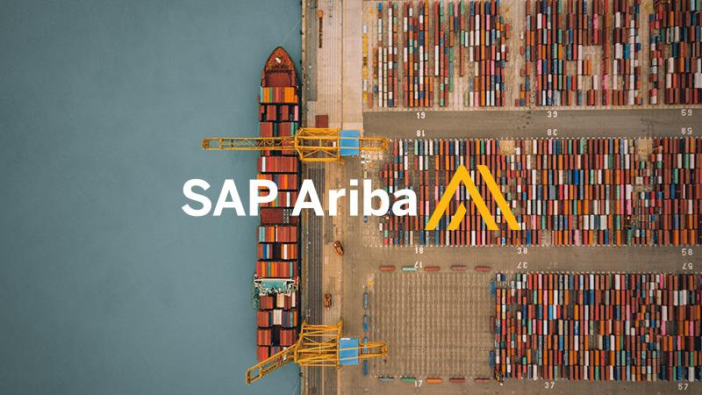

Slide 19
Changes and Benefits for Suppliers + Changes to Bidding on Contracts
2019
Launched SAP Ariba:
All bids go online
Benefits for Suppliers:
Fully digital bidding
Centralized email notifications
One portal to find and access opportunities
Streamlined, accessible, and fair process
2021
Added Supplier Lifecycle Module:
Easier updates + email alerts
2024
Introduced TO Bids Portal:
Replaced OCDS, public can see all opportunities
Notes:
Sep 2019 city moved to online procurement to ariba
Moved from accepting hard copy paper based
Bid submissions and solicitation documents are available 24/7 and are free of charge
October 2021 we introduced Supplier Lifecycle Performance module which is used to onboard and register Suppliers

Slide 20



Supplier Self-registration Request Form
Use the City of Toronto’s supplier registration link
General Supplier Info
  Legal Business name
  Main business address
Primary Contact
  First & last name
  Email & Phone
Additional Info
  Categories of goods/services
  Regions you serve
  Canadian Business status
  Approved suppliers will receive a registration invitation by email
.

Slide 21

Overview: SAP Ariba Account Setup (For Reference Only)
Suppliers who choose to register on SAP Ariba will go through the following:
Create an account with a username and password
Enter company details (name, address, contact info)
Select relevant product & service categories and service areas
Complete the company profile to gain full access to the Ariba Network
Note: This slide is informational only. The City does not require suppliers to create accounts unless bidding

Slide 22
SAP Ariba vs. Supplier Registration: What’s the Difference?
Feature | SAP Ariba Account Setup | Supplier Registration Questionnaire
What it is | Creates your Ariba login and company profile | Official City of Toronto registration for doing business
Purpose | Access and bid on City solicitations | City can approve you as a supplier in their financial/vendor system
Where it’s done | On the SAP Ariba Network | Through the City’s Supplier Registration Portal
Triggers | You choose to register on Ariba or access a bid | Usually requested by the City after award or by interest
Outcome | You can view and submit bids for opportunities | You're officially set up to receive payments and do business with the City

Slide 23




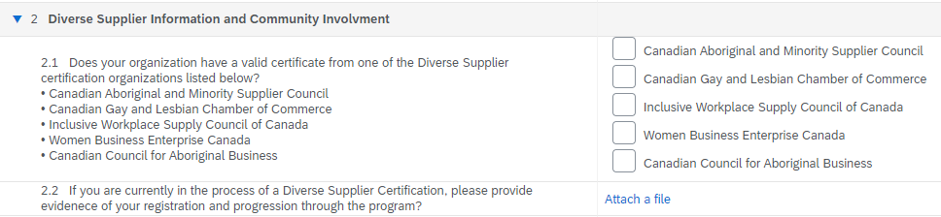
Diverse Supplier Information & Community Involvement

Slide 24
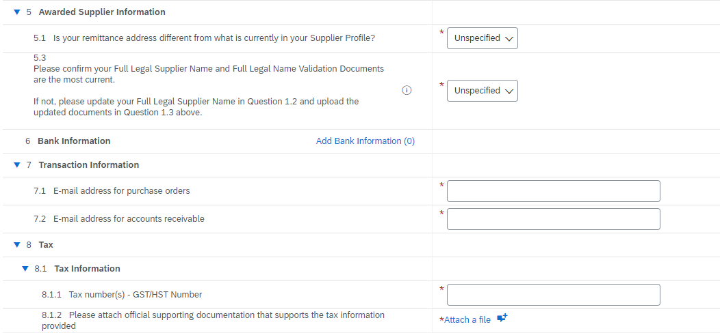
Awarded Supplier Information
Supplier Type | Information
Prospective / Historic Supplier | Sections 5–8 are hidden from view
Current / Newly Awarded Supplier | Must complete Sections: Bank Info Transaction Info Tax Info

Slide 25

Bidding an Event

Slide 26
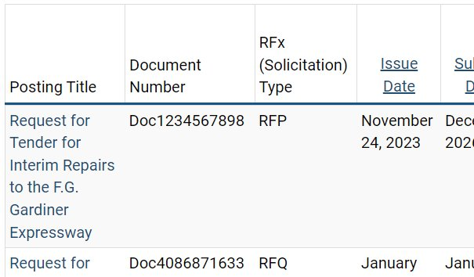
Locating Opportunities
From Searching and Bidding on City Contracts, expand “Search for Opportunities” and click on the link to the TO Bids Portal. TO Bids lists City solicitations in the following areas:​
  Goods & Services​
  Professional Services​
  Construction Services​
  Offers to Purchase​
Choose “All Open Solicitations” and use the Advanced Search features, click on the posting title of the posting you would like to view

Slide 27
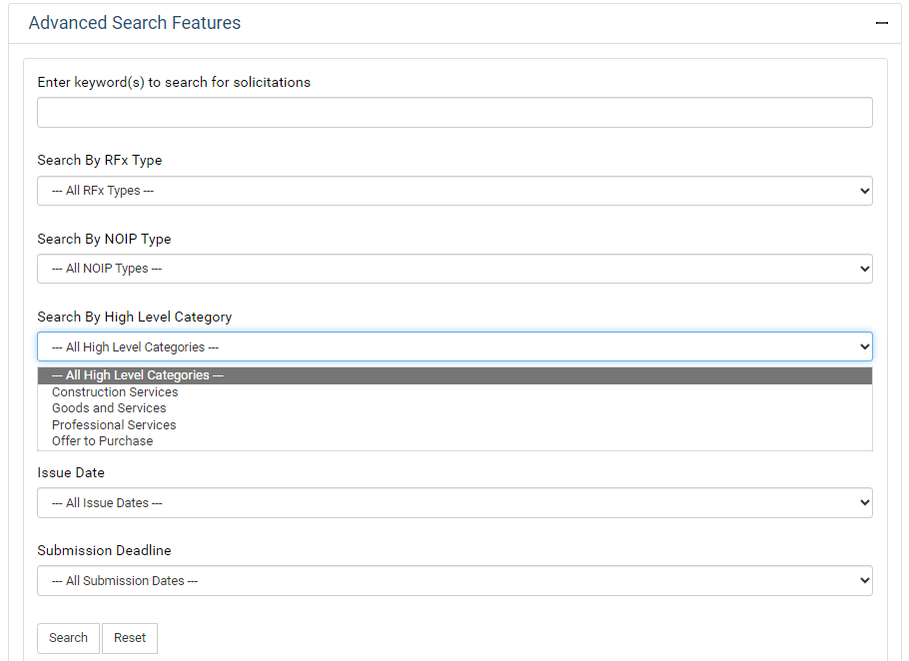
TO Bids Search Filters
Suppliers will be able to use the Advanced Search filters, you can search by:
  Keywords
  Solicitation (RFx) Type
  High Level Category (Goods and Services, Professional Services, Construction Services)
  Submission Deadline
  Award/Contract Date
  And more!

Slide 28
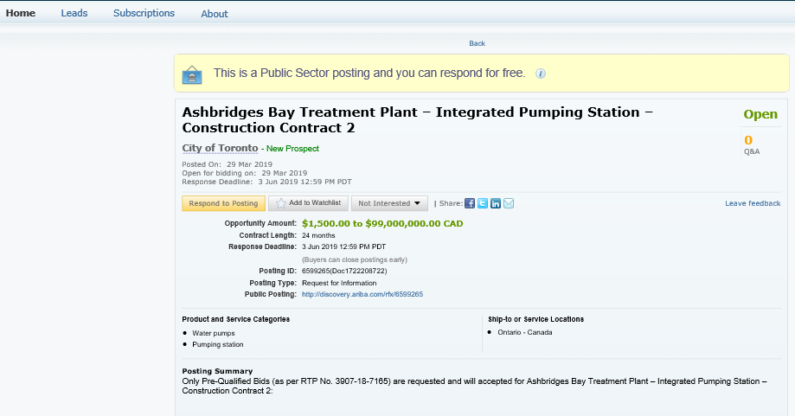
Supplier Research Posting

Slide 29

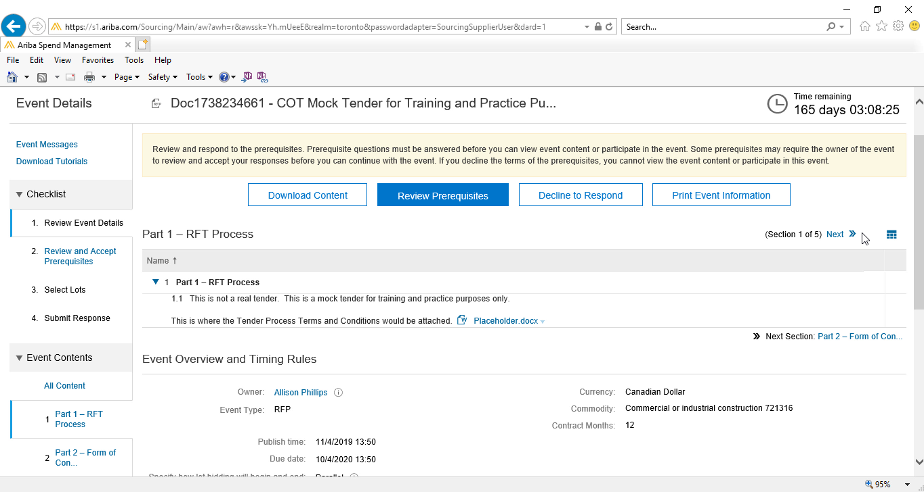

Event Details Page
Time Remaining: Submit your response before the countdown ends
How to respond:
Click Download Content
to save documents locally
or respond directly within
SAP Ariba

Slide 30

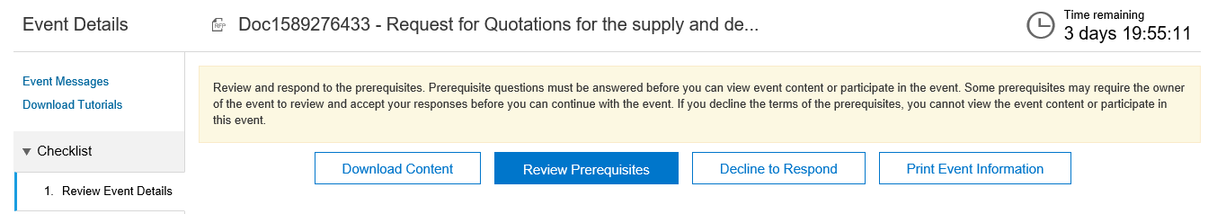
Contacting the City During an Event
During Active Events:
All communication must go through SAP Ariba
Use the Event Messages tab to ask questions

Slide 31
Useful Information Links
City of Toronto Transition to Ariba
SAP Ariba Registration (City of Toronto Registration Page)
SAP Ariba Login
SAP Ariba Supplier Guide
SAP Ariba Help Center

Slide 32

The Toronto Lobbyist Registrar
promotes and enhances the transparency and integrity of City government decision-making by maintaining a publicly available lobbyist registry and regulating the conduct of lobbyists.
The Lobbyist Registrar is one of the City’s four Accountability Officers. The Registrar is an independent accountability officer reporting to City Council.

Slide 33
The Registrar’s Team
Provides advice and interpretation regarding the Lobbying By-law.
Maintains the Lobbyist Registry.
Conducts compliance inquiries, and
Enforces Chapter 140, Toronto Municipal Code – the Lobbying By-law.

Slide 34

Do You Need to
Register as a Lobbyist?
Answer this quick and easy interactive questionnaire to find out.
START HERE

Slide 35
Lobbying and Procurement
One of the definitions of Lobby in the Lobbying By-law is:
  140-1: Lobby - To communicate with a public office holder on any of the following subject matters:
    B. (2) Procurement of goods, services or construction and awarding a contract.
For more information, please refer to Interpretation Bulletin: Lobbying and Procurements

Slide 36

Communicating about the procurement of goods, services, or construction; and awarding a contract is
LOBBYING

Slide 37
Blackout Period
We have not commenced a purchasing process to purchase widgets
We have not commenced a purchasing process to purchase widgets
Register
Register
Purchasing process for Widgets issued
Purchasing process for Widgets is awarded, or rescinded or revoked

Slide 38
Case Study One – Suppliers
A sales representative wants to meet with a public office holder to tell him/her about goods or services the City might be interested in buying. What should the lobbyist do?
This is lobbying.
The sales representative must register before speaking with a public office holder and must not lobby about a procurement process. Contact the TLR and/or refer the lobbyist for advice and information.

Slide 39
Case Study Two – Suppliers
Q. What if a public office holder wants to invite a company in to showcase their products or services?
A. This is lobbying, if communicating about a possible contract or procurement of goods and services; and prohibited if there is an active procurement. Register.

Slide 40
Case Study Three – Bidders
Q. A bidder in a competitive procurement wants to speak with a public office holder. Is this okay?
A. This is not okay, unless the public office holder being contacted is the contact person designated in the procurement document. Contact the TLR and the Purchasing and Materials Management Division for advice.
See TLR Interpretation Bulletin, Lobbying and Procurements on the Lobbyist Registrar website.

Slide 41
Registration Information
Registration with the office is free of charge and is completed online.
Lobbyists need to register before lobbying a Public Office Holder.
Registering to lobby is a two-part process. In order to begin lobbying, a lobbyist must have an approved lobbyist registration number and an approved subject matter number.
Lobbyists must log in and update your subject matter registration after you communicate with a public office holder. Lobbyists have three days to update their subject matters after communicating with a public office holder.
Communication can be in any form (meeting, phone, fax, letter or electronic communications such as email or through social media).

Slide 42
Resources on the TLR Public Website
Lobbying By-law
Lobbyist Code of Conduct
Interpretation Bulletins
Video Tutorials
Search the Lobbyist Registry
Reports

Slide 43
How to Contact Us
Lobbyist Registry Advisors are available:
Monday to Friday
9 am to 4 pm
Tel.: 416-338-5858
E-mail: lobbyistregistrar@toronto.ca

Slide 44
Questions?

