Slide 1
​​Automated Vehicle Pilot Deployment in Toronto Under the Highway Traffic Act​
Jennifer Niece,
Manager, Strategic Policy & Initiatives, Transportation Services.
Jennifer.niece@toronto.ca
O: 416-397-9710
Rahmatullah Sherzai,
Project Manager, Strategic Policy & Initiatives, Transportation Services.
Rahmatullah.Sherzai@toronto.ca
O: 647-642-4337
Notes:
- This ten year pilot allows Ontario to establish rules, monitor industry developments and evaluate the on-road operation of AVs included in the pilot prior to them becoming widely available to the public.
Avs included in the pilot are motor vehicles (passenger and commercial) or streetcars, excluding motorcycles and motor-assisted bicycles, with an automated driving system that operates at Society of Automotive Engineers (SAE) International driving automation Level 3, 4, or 5.
The City has seen operations of automated vehicles expanding in many parts of the United States and anticipates there will be more demand in future in Toronto. This modest pilot with low-speed vehicles is an important opportunity to increase our knowledge on the state of the technology.

Slide 2
Introduction & Objective
Ontario’s Autonomous Vehicle Pilot Program:
On January 1, 2016, Ontario Regulation 306/15: Pilot Project - Automated Vehicles(AV) – 10 years pilot program.
Ontario reserves the regulatory authority and does not give municipalities the choice to approve or reject any application.
The City of Toronto has no official role in this pilot. It is led by Magna International and approved by the MTO.
In December 2024, Magna has approached MTO with an application to test their AVs in Toronto in 2025.
MTO Contacted City of Toronto to provide municipal perspective on the application.
It is in our interest to be active partners to maximize opportunity to mitigate risks and to learn from the experience.
Notes:
- This ten year pilot allows Ontario to establish rules, monitor industry developments and evaluate the on-road operation of AVs included in the pilot prior to them becoming widely available to the public.
Avs included in the pilot are motor vehicles (passenger and commercial) or streetcars, excluding motorcycles and motor-assisted bicycles, with an automated driving system that operates at Society of Automotive Engineers (SAE) International driving automation Level 3, 4, or 5.
The City has seen operations of automated vehicles expanding in many parts of the United States and anticipates there will be more demand in future in Toronto. This modest pilot with low-speed vehicles is an important opportunity to increase our knowledge on the state of the technology.

Slide 3
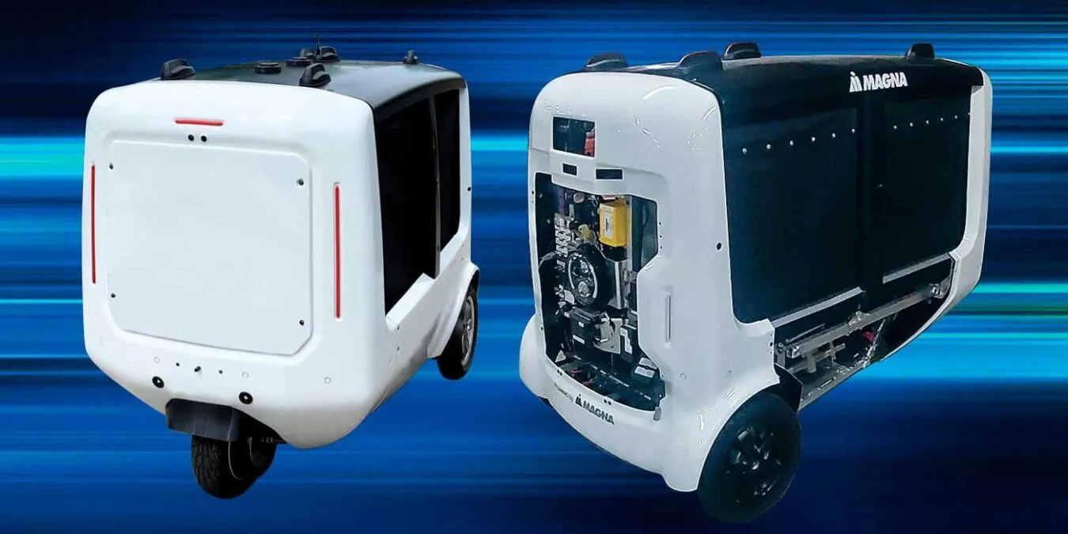
Magna International Inc.
Ontario-Based Mobility Technology Company
Magna-developed a level 4 (Fully Driverless) autonomous driving system and delivery software
All-Electric Last Mile Delivery Device (LMMD)
Delivering goods curbside delivery only.
Has been in operation in Birmingham Michigan since March 2022 in various environments.

Slide 4
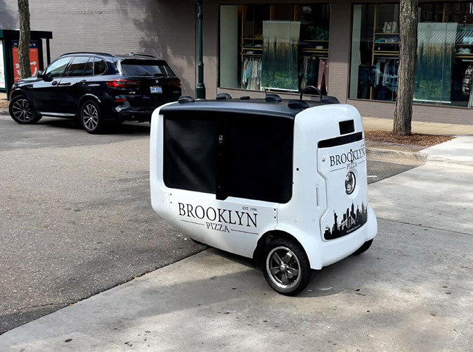
AV’s Technical Specifications
3-wheeler small size vehicle.
360-degree horizontal field of view.
Equipped with 360-degree cameras, radar, lidar, and GPS.
Maximum Speed 32km/h.
Range of view of the sensors is at least 50 meters.
Chase vehicle and remote supervisor (in Toronto).

Slide 5
Operational Design Domain (ODD)
Road surface: Concrete, asphalt and other pavement. No grass, dirt or gravel.
Road type: Surface roads and laneways (≤40 km/h).
Will not drive on sidewalks, bike lanes, and Vulnerable Road Users (VRU) areas.
Can cross high speed roads or VRU areas.
Parking lots and private roads operation is managed by Safety Chase Supervisor.
Driveable on maximum up/down slope of 20 degree.
Safety Measures:
Constant human oversight (Safety Chase Supervisor and Remote operator) for each vehicle, capable of immediate control in complex scenarios.
Live communication between the chase supervisor and the remote operator.
No left turns.
No operation in heavy rain, heavy snow, unfavourable road conditions like gravel, grass, and unlit nighttime areas.

Slide 6
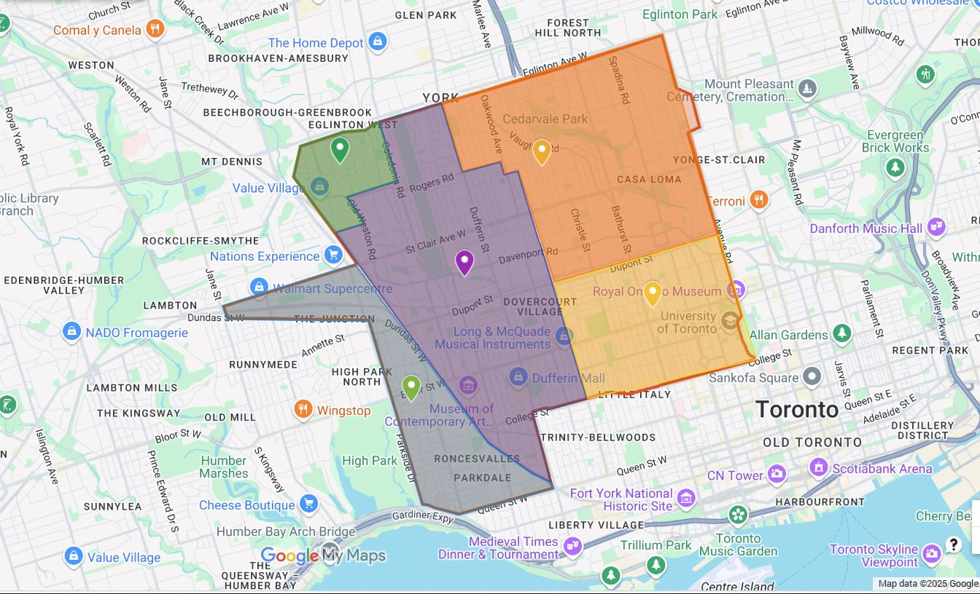
Deployment Area (Criteria for selection)
Includes Eglinton to the north, Avenue to the east, College and Queen to the south, Parkside, Keele and Jane to the west.
Notes:
The Toronto Automated Vehicles (AV) Tactical Plan & Technical Report outlines the City of Toronto’s strategy for integrating automated vehicle technology into its transportation network. It assesses the potential impacts of AVs on safety, mobility, equity, and sustainability while considering regulatory frameworks, infrastructure needs, and public engagement. The report identifies key focus areas, including road safety improvements, data management, transit integration, and economic opportunities.
- The Toronto City Council Decision 2020.IE11.9 report focuses on transportation innovation and modernizing mobility through emerging technologies, including automated vehicles (AVs). It highlights the importance of policy development, data governance, safety regulations, and pilot programs to integrate AVs into Toronto’s transportation system.

Slide 7
Deployment Area and Operations
Working with retailer partners to communicate process of delivery.
Using safety chase supervisor to get out and facilitate getting item to help avoid confusion
Continuous operations during working hours, otherwise will be parked at Magna’s facility
Cloud-based cargo compartment management with real-time monitoring via cameras.
Ongoing R&D in active thermal management for hot, warm, cold, and freezing food delivery.
Regular sanitation inspections and food-safe sanitization tools provided to operations teams to maintain cleanliness between deliveries.
Cameras inside each cargo compartment to monitor food safety, detect spills, and aid in troubleshooting to prevent future incidents.
Notes:
The Toronto Automated Vehicles (AV) Tactical Plan & Technical Report outlines the City of Toronto’s strategy for integrating automated vehicle technology into its transportation network. It assesses the potential impacts of AVs on safety, mobility, equity, and sustainability while considering regulatory frameworks, infrastructure needs, and public engagement. The report identifies key focus areas, including road safety improvements, data management, transit integration, and economic opportunities.
- The Toronto City Council Decision 2020.IE11.9 report focuses on transportation innovation and modernizing mobility through emerging technologies, including automated vehicles (AVs). It highlights the importance of policy development, data governance, safety regulations, and pilot programs to integrate AVs into Toronto’s transportation system.

Slide 8
Deployment Area and Operations
Goods Magna City Delivery will not deliver:
Dangerous goods (explosives, flammable, poisonous, corrosive materials)
Illegal goods
Age or identity restricted goods (prescription drugs, alcohol)
Goods Magna City Delivery will deliver:
General retail products (groceries, clothing, electronics, consumer goods)
Non-hazardous foods (hot, warm, cold, frozen foods)
Notes:
The Toronto Automated Vehicles (AV) Tactical Plan & Technical Report outlines the City of Toronto’s strategy for integrating automated vehicle technology into its transportation network. It assesses the potential impacts of AVs on safety, mobility, equity, and sustainability while considering regulatory frameworks, infrastructure needs, and public engagement. The report identifies key focus areas, including road safety improvements, data management, transit integration, and economic opportunities.
- The Toronto City Council Decision 2020.IE11.9 report focuses on transportation innovation and modernizing mobility through emerging technologies, including automated vehicles (AVs). It highlights the importance of policy development, data governance, safety regulations, and pilot programs to integrate AVs into Toronto’s transportation system.

Slide 9
Cybersecurity and privacy Considerations
Cybersecurity and Privacy: Adherence with PIPEDA, and other internationally recognized cybersecurity and privacy standards.
Remote operations of the Vehicle are conducted through a private “VPN.”
Notes:
- ISO 27001: Leading international standard for information security management
- TISAX (Trusted Information Security Assessment Exchange) is a European automotive industry-specific information security assessment and exchange mechanism, developed by the ENX Association on behalf of the VDA (German Association of the Automotive Industry), ensuring secure data sharing within the automotive supply chain.
- ISO 26262: an international standard for functional safety in the automotive industry, focusing on the development of electrical and electronic (E/E) systems to ensure safety throughout the vehicle lifecycle

Slide 10
The application process
Magna’s initial Application in December 2024 to MTO included:
Response to Annex A of Transport Canada Safety Assessment for AV/CV.”
Response to Guidelines for Submitting a Work Zone and Law Enforcement Interaction Plan to the City of Toronto.
Moving forward, Magna has responded to:
Follow up questions by MTO.
Follow up questions by the City of Toronto.
Questions from City’s AV-Interdivisional Working Group (AV-IDWG).
Attended in 2-hours workshop session with the City’s AV-IDWG.
Promised to hold additional sessions for City’s Emergency services and first responders.
Magna Received verbal approval from MTO in mid-March, 2025.

Slide 11
Pilot Timeline
A phased approach: Initially deploy two vehicles and incrementally add vehicles over the course of the year based on safe operation.
Successful operations with a smaller number of vehicles may justify expansion.
Further MTO approval will be required for each incremental increase in number of vehicles.
Magna hopes to deploy up to 20 vehicles by the end of 2025.

Slide 12
Questions and Discussions
Thank you

Slide 13
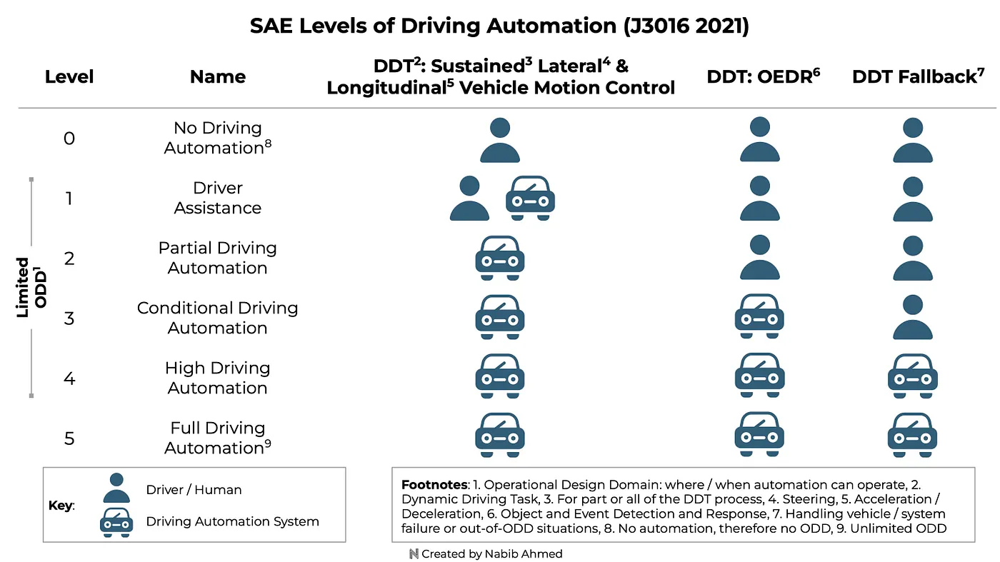
SAE Levels of Driving Automation

