Slide 1
Event Support Office
Arts and Culture Services
Economic Development and Culture

Slide 2
Guidance
Consultation & Facilitation
The Event Support Unit (ESU) provides support to third-party organizers by offering planning assistance, guidance, and direction to appropriate City resources and agencies
This includes but is not limited to, the co-ordination of festival and event resource materials, seminars, event facilitation, governance, permitting of Nathan Phillips Square, consultation and project management for event organizers presenting signature events.

Slide 3
Our Portfolio
Festival and Event Planning Guidance and Information Sharing.
Festival and Event Planning Working Groups.
Special Events Advisory Team (SEAT).
Sector Development and Industry Engagement.
Bidding & Hosting.
Summerlicious & Winterlicious.
Technology Permitting Solution.
Festival and Event Strategy.

Slide 4
Festival and Event Working Groups
Event Support Supervisors act as the primary point of contact for event organizers for sizeable events and those with greater complexities.
This involves organizing meetings for event organizers with City Divisions, Agencies and Commissions (DACs) who will advise, support and problem solve, to ensure risks are minimized and impacts to the community are mitigated, in order to support the successful provision of services.

Slide 5
Special Events Advisory Team (SEAT)
An interdivisional working group, composed of representatives from various City of Toronto Divisions, Agencies, and Commissions (DACs), meets monthly to review past and upcoming events and to provide guidance on any scheduled or unforeseen disruptions requiring attention.
The Event Support Unit (ESU) chairs meetings, facilitates discussions, and oversees all communications within the group. Through a critical lens, it identifies risks and potential issues and takes appropriate actions to mitigate them.
Since its establishment in 2023, the Special Events Advisory Team (SEAT) has played a pivotal role in enhancing and fostering internal communications.

Slide 6
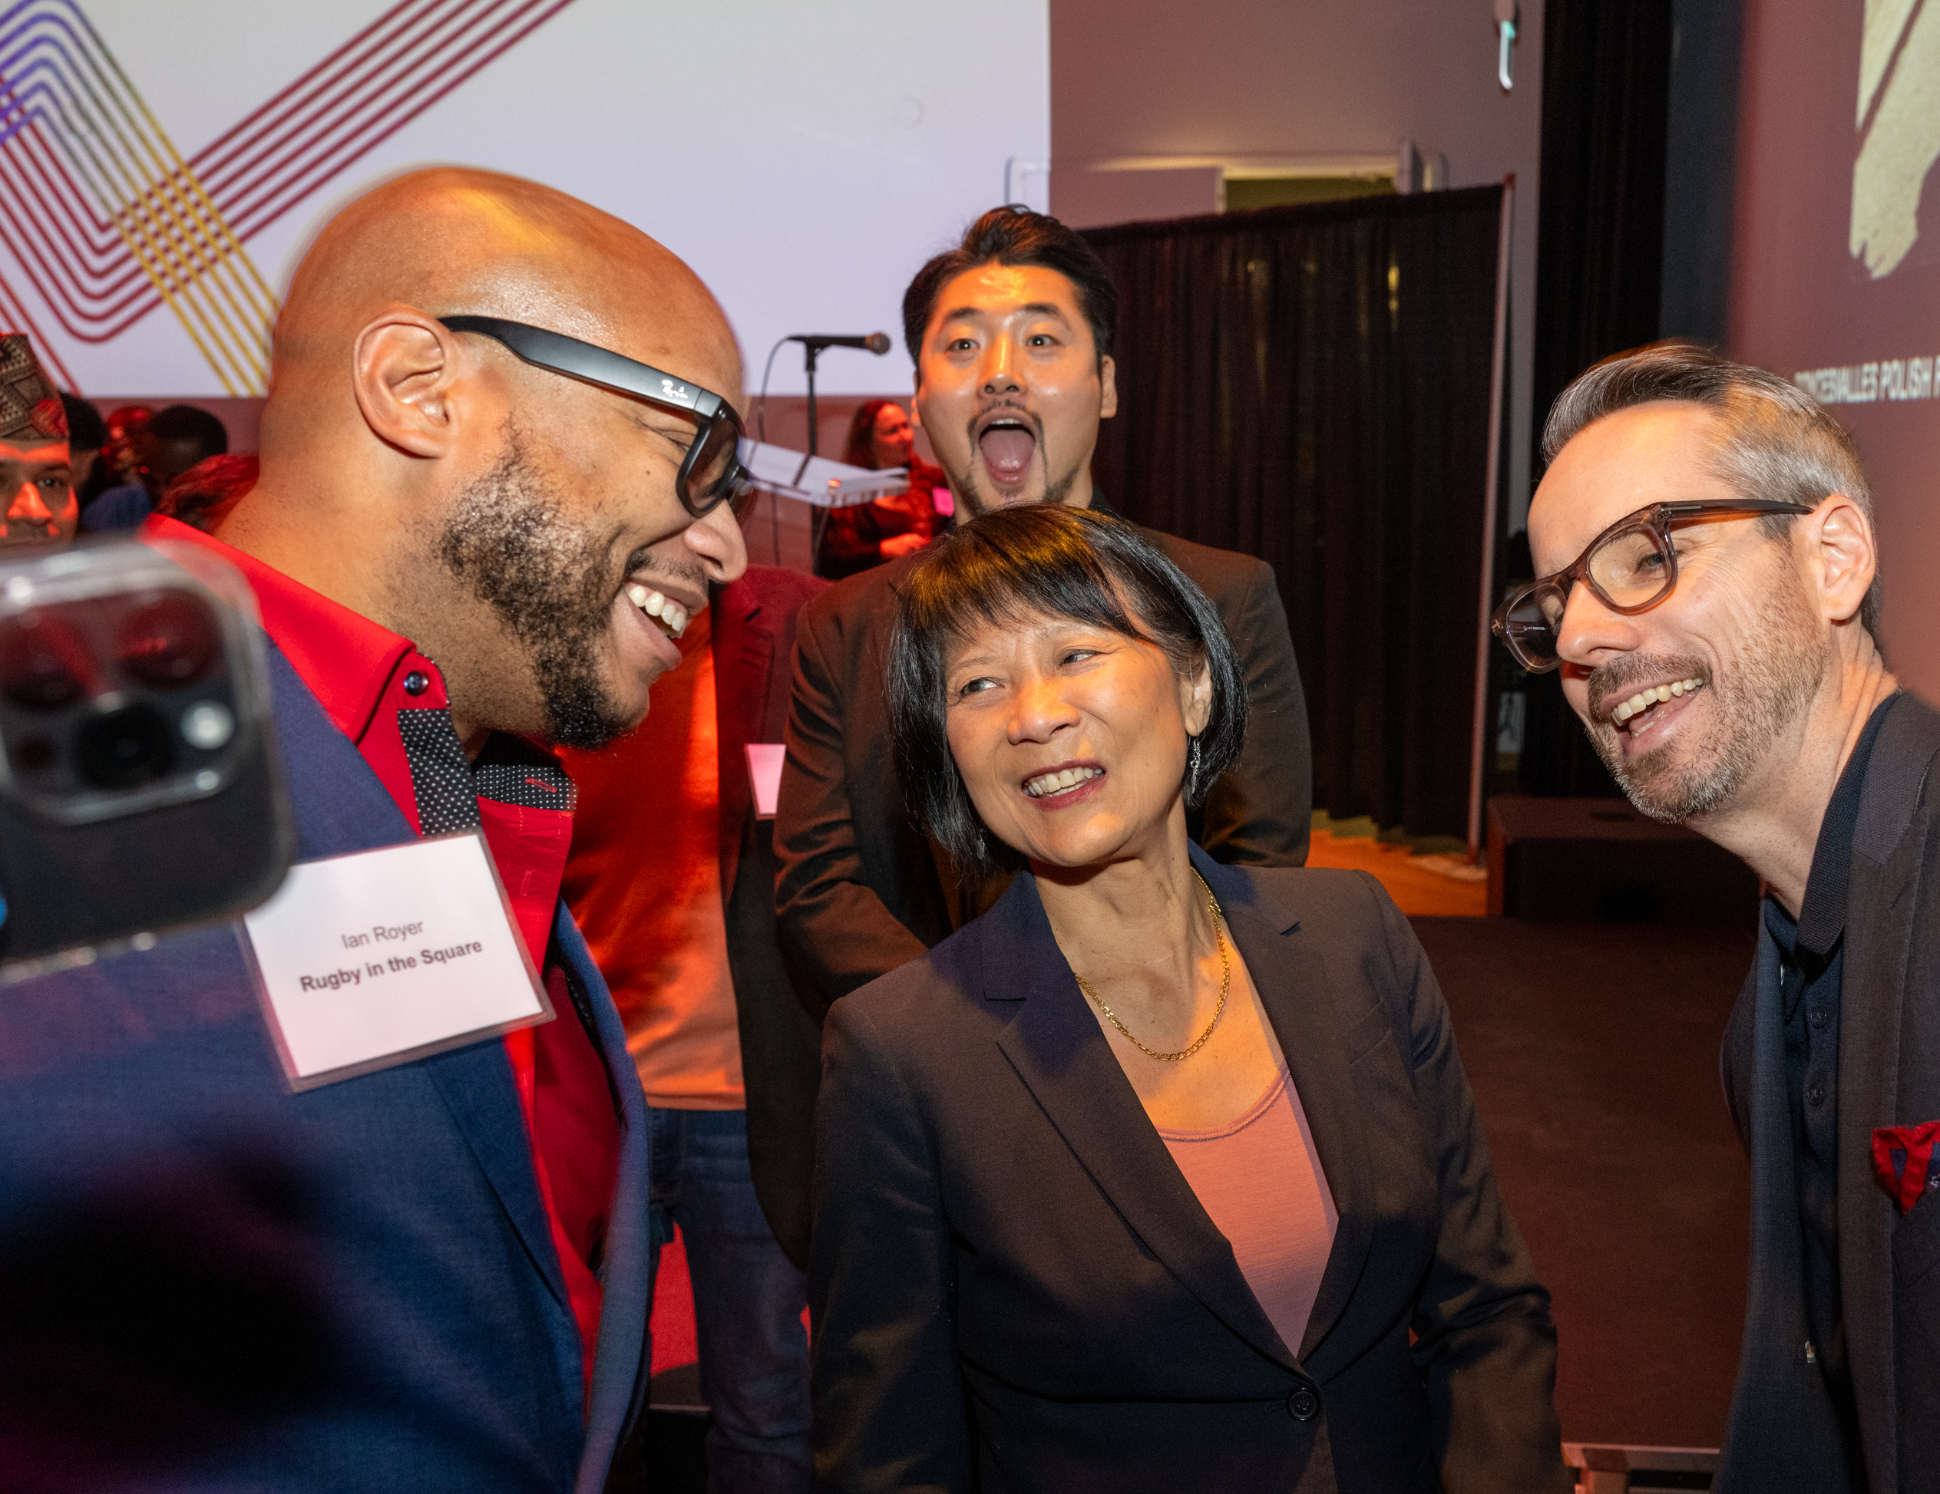
Sector Development & Industry Engagement
Festival & Events Network
Bi-annual meetings for event sector. City staff share useful information and industry updates.
Mayor’s Reception
Annual reception in recognition of the substantial contribution that festivals bring to Toronto.

Slide 7
Bidding & Hosting
Bidding for large-scale events entails a structured and competitive process. Such events generate significant economic, cultural, and social benefits for the City of Toronto. Successfully securing them requires extensive preparation, strategic investment, and close collaboration with agencies including Destination Toronto.
2026 FIFA World Cup
June11- July 19 – Six Games (Toronto)

Slide 8
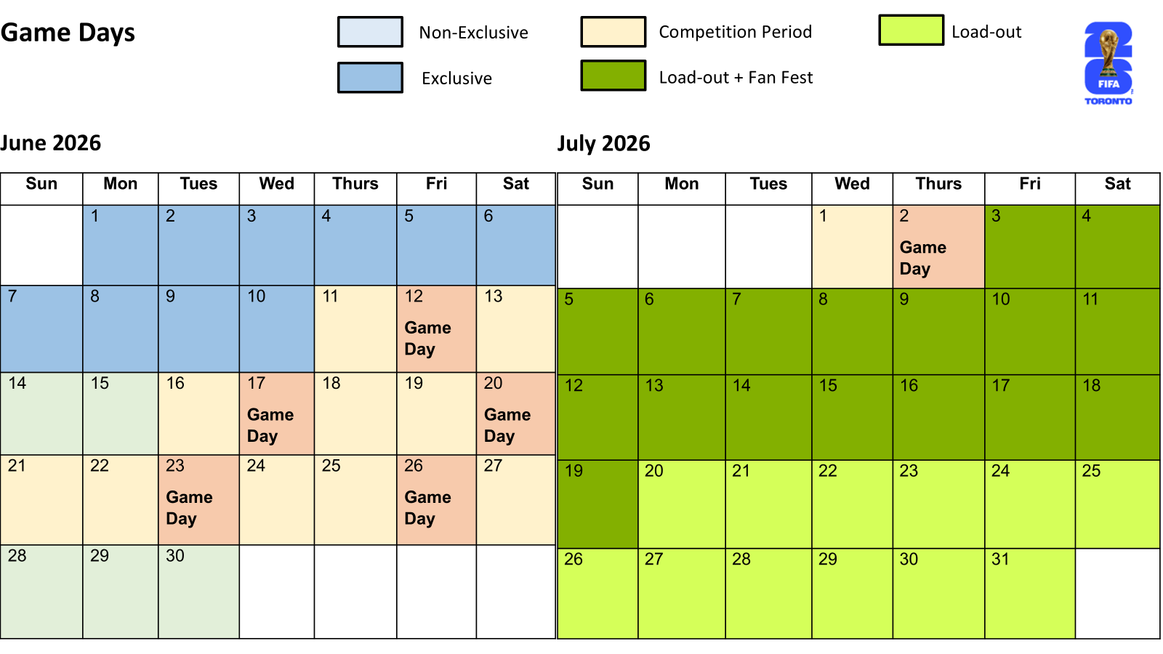
FIFA World Cup 2026

Slide 9
FIFA World Cup 2026

Slide 10
Grant Administration
Cultural Festivals Funding Program (CFFP) is an initiative by the City of Toronto that provides financial support to recurring cultural festivals taking place in public spaces and which are free to attend.
Special Events Stabilization Initiative (SESI) a funding program introduced in 2024 to provide financial relief to local event organizers facing increased health, safety and security costs.
Toronto Significant Event Investment Program (TSEIP) exists to support the City’s strategy for bidding and hosting significant events, specifically those that offer substantial economic, social, and cultural benefits to Toronto.

Slide 11
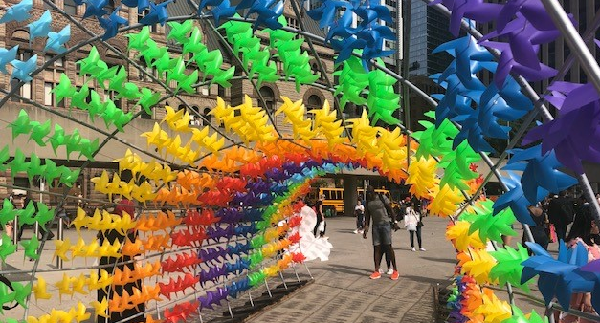
Nathan Phillips Square Event Permitting
Issuing permits, application and evaluating submissions.
Working with internal divisions.
Supporting event organizers in permissions and permit requirements.

Slide 12
Summerlicious & Winterlicious
Winterlicious – February – 2 weeks
Summerlicious – July - 2 weeks
Established in 2003 with 35 restaurants as a SARS marketing program, over 150 restaurants in 2025
Designed to provide guests with a special in-restaurant dining experience while promoting Toronto’s finest culinary offerings.
$20 to $55 for lunch and $25 to $75 for dinner.

Slide 13
Technology Solution - Permitting
What permits and approvals do I need?
What do I need to submit?
Who can I connect with?
What's the status of my permit?
How do I pay for my permit?
Length of permit process?
A digital solution to streamline the permitting process for event organizers
Release 1
Launching post festival season
The special events permit navigator
Future releases
To be initiated after R1
Intake, status, integration, mapping

Slide 14
Festival and Event Strategy
Purpose: To support the development of a robust, achievable and responsive strategic report and workplan for the City’s engagement and partnership with the festival and special events sector
The Festival Strategy aims to respond to the ongoing need of the sector as a key contributor to Toronto’s cultural landscape, and to build upon existing relationships, partnerships, and programs to deliver targeted support to organizers. It also aims to provide improved access and engagement for members of the public, as festivals and special events contribute to the diversity of the city’s economy, it’s cultural vibrancy, and overall liveability.
Four priority areas:
Sector stabilization – Provide sector support.
Vibrancy and diversity – Increased focus on events outside of the core and representing equity-deserving communities.
Events for all, big and small – increased access aiming to reduce red tape for events of all sizes.
Festival city of the future – long-term sustainability supports and investment.

Slide 15
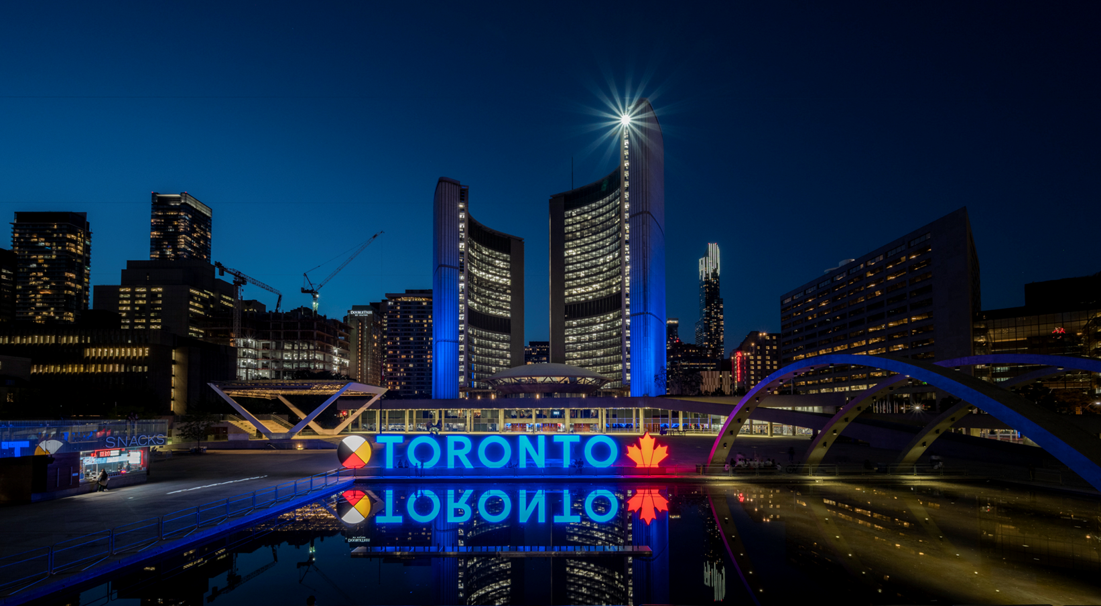
Resources
Events Planning Guide Website:
toronto.ca/business-economy/industry-sector-support/events/
Festival and Events Calendar – City of Toronto Website:
toronto.ca/explore-enjoy/festivals-events/festivals-events-calendar/
Festival & Event related questions can be directed to:
eventsupport@toronto.ca
416-392-0490

Slide 16
Upcoming Event
Toronto Festival and Event Safety Summit
Monday May 26, 2025 – 9:00 a.m. to 12:00 p.m.
The Toronto Festival and Events Safety Summit will convene City of Toronto staff, agency representatives, and emergency services personnel to discuss public safety measures related to festivals and events.

Slide 17
Thank you.

