Slide 1

2023 - 2024
CityWide Program
Preferred Advertising Rates for Member BIAs

Slide 2


Pattison
TTC advertising
Download Media Kit:
Pattison Media Kit - Detailed
Pattison Media Kit Overview
*See Astral Out of Home for TTC bus shelters​

Slide 3
Pattison
Rate Card
Product | Pricing | Notes
Full Streetcar Wrap | $37,000 per 4 weeks | 8 week Minimum Plus Production: $23,600
Driver side ONLY | $30,000 per 4 weeks | 8 week Minimum Plus $9,280 per streetcar
Driver Side Strips | $22,500 per 4 weeks | Plus Production $5,840 per streetcar
Curb Side Strips | $9,500 per 4 weeks | Plus Production $5,250
Driver & Curb Side Strips | $32,000 per 4 weeks | Production $11,000 per streetcar
Driver Side Triple Streetcar Mural (Top) | $22,500 per 4 weeks | 8 week Minimum Plus $4,775 per streetcar
Single Streetcar Mural (Bottom) | $9,500 per 4 weeks | 8 week Minimum Plus Production $2,000 *Choose driver or curb side for placement
Streetcar Interior Domination (Includes 28 interior cards, 8 vertical interior cards, Full ceiling decal) | $4,200 per 4 weeks | Plus Production $6,000
Subway Mural (Includes mural on both sides of train, subway car interior domination) | $20,000 per 4 weeks | Plus Production $4,600
Single Subway Car Interior Domination | $6,250 per 4 weeks | Plus Production TBD at booking
Entire Train Interior Domination | $37,500 per 4 weeks | Plus Production TBD at booking
Subway Door Surround Max (Includes 1 Super Interior Card, 2 Interior Cards, 2 Vertical Posters) | $750 per 4 weeks | Plus Production $250
100 Interior Subway Posters (Choose either vertical or horizontal and subway line) | $4,900 (per 100) | Plus Production $1,575 (per 100) Contact TABIA for campaign pricing for more/less than 100 posters
TTC Station Posters (Top)
Outside Lower U | $500 each per 4 weeks (Reg. $1,500) | Plus Production $100 each
Inside Lower U | $750 each per 4 weeks (Reg. $2,000) | Plus Production $100 each
TTC Station 28 Posters (Bottom)
Outside Lower U | $95 each per 4 weeks (Reg. $500) | Plus Production (dependent on quantity)
Inside Lower U | $125 each per 4 weeks (Reg. $750) | Plus Production (dependent on quantity)
TTC Seventy Posters (Top) | $275 each per 4 weeks (Reg. $550) | Plus Production (dependent on quantity)
TTC King Posters | $300 each per 4 weeks | Plus Production (dependent on quantity)
Billboards *Contact TABIA for location details
Horizontal (Top) | $1,500 each per 4 weeks (Reg. $3,000) | Plus Production $125 each
Vertical (Middle) | $1,000 each per 4 weeks (Reg. $3000) | Plus Production $125 each
Digital (Bottom) | $1,500 - $3,000 per face per 4 weeks | No Production cost
Digital Residential Network (condominium, high-rise buildings – common areas and elevators) | $7,000 - $10,000 | No Production cost
2022 Rates honoured, over 60% discount available

Slide 4
New Offer - Poster + Digital Network
TTC digital network program - a 15 second ad playing every other loop in 9 Stations in the Lower U.
Total cost is $3,300 for 14 days.
Add the attached digital program onto 100 Poster subway campaign and your subway poster rate will be reduced to $41 to help offset the digital cost.
Add a TTC digital program equivalent to at least $3k and receive the $41 subway poster rate. Can pick and choose individual stations to suit the specific BIA if the Lower U package doesn’t make sense. You will most likely need to add more than 9 stations as the ones outside the Lower U are cheaper. We can also use less Stations for 4 weeks to get to the $3k.
TTC Subway & Digital Program
100 Posters X 4 weeks = $4,100
TTC Digital Program = $3,300
Total Media Cost = $7,400
Production Cost = $1,400
Total Campaign Cost = $8,800

Slide 5

Curiocity Toronto
Download Media Kit: Curocity Toronto Media Kit

Slide 6

Curiocity Toronto Rate Card
Curiocity - Display Advertising
Product | Pricing | TABIA | Notes
ROS Display Ads | $18 CPM | $15 CPM | Ads will run across the site, on both desktop and mobile.
Section Takeover | $30 CPM | $25 | Ads will run in one or more sections of the site, on both desktop and mobile.
Curiocity - Social Media
Product | Pricing |  | Notes
Instagram - Hosted Reel | $2,000 | $1,667 | A Curiocity host will come to your venue and create a 60 to 90 second video based on your direction, and will post it to their Instagram account.
Instagram - Reel - Video provided by client | $1,750 | $1.459 | You may provide a video of your own creation, Curiocity may choose to edit the video to make it align more with their voice. The video will post it to Curiocity's Instagram account.
Instagram - Hosted Story | $1,500 | $1,250 | A CurioCity host will come to your venue and take video footage based on your direction, to produce 4 to 5 Instagram Story Slide videos, and post them to the Curiocity Instagram Story feed.
Instagram - Post/Carousel | $1,500 | $1,250 | Curiocity will post up to 6 lifestyle photos of your venue to the grid of their Instagram account. For an additional $300, a Curiocity photographer can come to your venue and take photographs for the Post/Carousel.
Instagram - Single Story Slide | $500 | $417 | You may submit one photo or poster with swipe-up text and a destination URL, and Curiocity will post it to their Instagram Stories feed.
Instagram - Contest | $1,750 | $1,459 | Engage, spread awareness and create brand loyalty with followers of Curiocity through a sponsored Instagram Contest posted to their feed. Prize fulfilled by client, Client @mentions, preferred copy direction, up to 4 client provided photos.
Facebook - Post/Carousel | $750 | $625 | Client can submit up to 4 photos with a caption and a destination URL, and Curiocity will post it to their Facebook page for users to find when they are scrolling through their news feed organically
Curiocity - Advertorial
Product | Pricing |  | Notes
Advertorial/Sponsored Article | $1,250 | $1,042 | The talented team of Curiocity writers will curate an Advertorial piece about your business. You may provide up 4 product or lifestyle photos, and desired click URLs. The article will be promoted on Curiocity's home page, in an Instagram Story, as well as a Facebook Share. https://curiocity.com/city-of-toronto-victoria-day-fireworks-show-2023/ https://curiocity.com/q107-canada-day-weekend/
Curiocity - Sponsored Content
Product | Pricing |  | Notes
Sponsored Thing to Do (TTD) | $750 | $625 | The article will be promoted on Curiocity's home page, in an Instagram Story, as well as a Facebook share. https://curiocity.com/things-to-do-in-toronto-on-victoria-day-monday/
20% discount off all tactics
3 Instagram Single Story Slides for the 4th slide free

Slide 7
Curiocity Toronto Example Package
Curiocity Toronto x TABIA Package
Product | Pricing | Notes
Curiocity - Instagram - Hosted Reel | $2,000 | A Curiocity host will come to your venue and create a 60 to 90 second video based on your direction, and will post it to their Instagram account.
Curiocity - Instagram - Post/Carousel | $1,500 | Curiocity will post up to 6 lifestyle photos of your venue to the grid of their Instagram account. For an additional $300, a Curiocity photographer can come to your venue and take photographs for the Post/Carousel.
Curiocity - Instagram - Contest | $1,750 | Engage, spread awareness and create brand loyalty with followers of Curiocity through a sponsored Instagram Contest posted to their feed. Prize fulfilled by client, Client @mentions, preferred copy direction, up to 4 client provided photos.
Curiocity - Advertorial/Sponsored Article | $1,250 | The talented team of Curiocity writers will curate an Advertorial piece about your business. You may provide up 4 product or lifestyle photos, and desired click URLs. The article will be promoted on Curiocity's home page, in an Instagram Story, as well as a Facebook Share. https://curiocity.com/city-of-toronto-victoria-day-fireworks-show-2023/ https://curiocity.com/q107-canada-day-weekend/
Curiocity - Sponsored Thing to Do (TTD) | $750 | The article will be promoted on Curiocity's home page, in an Instagram Story, as well as a Facebook share. https://curiocity.com/things-to-do-in-toronto-on-victoria-day-monday/
Total: | $7,250
Total with BIA Discount: | $5,800 | 20% discount for all tactics

Slide 8

Suite 66
Curiocity Toronto, Taste Toronto, Streets of Toronto

Slide 9

Streets of Toronto
Download Media Kit: Streets of Toronto Media Kit

Slide 10

Streets of Toronto
Rate Card
Streets of Toronto - Display Advertising
Product | TABIA | Notes
ROS Display Ads | $12 CPM | Ads will run across the site, on both desktop and mobile. Recommended buy is 70,000 Impressions $1050.
Streets of Toronto - Social Media
Product | TABIA | Notes
Instagram - Hosted Reel - with FB + TW + TT extension | $1,800 | A Streets of Toronto host will come to your venue and create a 60 to 90 second video based on your direction, and will post it to their Instagram, Twitter, Facebook and TikTok feeds.
Instagram- Hosted Reel- with FB + TW + TT extension with TT boost | $2,200 | A Streets of Toronto host will come to your venue and create a 60 to 90 second video based on client direction, and will post it on the SOT Instagram, Facebook, Twitter and Tik Tok feeds. Included in this package is a $500 Tik Tok boost fee that will be customized and targeted to reach your desired audience.
Instagram - Hosted Story | $1,200 | A Streets of Toronto host will come to your venue and take video footage based on your direction, to produce 5 to 7 Instagram Story slide videos, and post them to the Streets of Toronto Instagram Story feed.
Instagram - Post/Carousel | $800 | Streets of Toronto will post up to 6 lifestyle photos of your venue to the grid of their Instagram account. For an additional $300, a Streets of Toronto photographer can come to your venue and take photographs for the post/Carousel.
Instagram - Single Story Slide | $680 | You may submit one photo or poster with swipe-up text and a destination URL, and Streets of Toronto will post it to their Instagram Stories feed.
Instagram - Contest | $1,200 | Engage, spread awareness and create brand loyalty with followers of Streets of Toronto through a sponsored Instagram Contest posted to their feed. Prize fulfilled by client, Client @mentions, preferred copy direction, up to 4 client provided photos.
Facebook - Post/Carousel | $600 | Client can submit up to 4 photos with a caption and a destination URL, and Streets of Toronto will post it to their Facebook page for users to find when they are scrolling through their news feed organically
Twitter - Post/Carousel | $600 | Client can submit up to 4 photos with a caption, client @mention and desired hashtags.
Streets of Toronto - Advertorial
Product | TABIA | Notes
Advertorial/Sponsored Content (Original content by SOT) | $1,680 | The talented team of Streets of Toronto writers will curate an Advertorial piece about your business. You may provide 3 to 4 product or lifestyle photos, brand logo and desired click URLs. The article will be promoted on SoT home page for 3 days as well as Facebook, Twitter and their Instagram Story feeds.
Advertorial/Sponsored Content (Client provided Content) | $1,400 | Client provided article, edited and approved by the Streets of Toronto editorial team. Client can also provide 3 to 4 product or lifestyle photos, client logo, desired URLs. The article will be promoted on SoT home page for 3 day as well as Facebook, Twitter, and their Instagram Story feeds.
Streets of Toronto - Newsletter
Product | TABIA | Notes
Weekly Food Newsletter | $625 | Every Saturday morning the Streets of Toronto food newsletter is sent to 17,100+ subscribers (39.6% open rate). You can choose one of two placements; a native-tile placement, in place of the 3rd Article (that looks like an article), or an image ad (size 625x525pix). Both products are the same price per execution. You may provide a desired click URL for the ads. The most recent newsletter can be found here: https://mailchi.mp/streetsoftoronto/food-172?e=2109790982
Bi-weekly Real Estate Newsletter | $625 | Every second Tuesday the Streets of Toronto real estate newsletter is sent to 11,300+ subscribers (42.5% open rate). You may choose one of two placements, a native-tile placement, in place of the 3rd Article (that looks like an article), or an image ad (size 625x525pix). Both products are the same price per execution. You may provide a click URL for the ads. The most recent newsletter can be found here: https://us20.campaign-archive.com/?u=d5c7cf041eb19346156cfcf01&id=c25d4966c3
The Concierge List | $400 | Sent on the first of every month. The three coloured squares below images can be sponsored
Streets of Toronto - Sponsored Content
Product | TABIA | Notes
Custom - 3 [insert word] things to do this weekend (Website) | $1,115 | Streets of Toronto editorial team will create a customized listicle article with Top things to do in the city, related to your event/show. Client can own a sponsored placement at the beginning of the article where client event will appear as a "Top thing to do". Client may provide copy direction, URL and client images. The article lives on the home page for 3 days, and is shared on Facebook, Twitter and Instagram Stories.
20% discount on all tactics
*Discount already applied

Slide 11

Taste Toronto
Download Media Kit: Taste Toronto Media Kit

Slide 12

Taste Toronto
Rate Card
3 or more tactics purchased, get 15% discount
3 Instagram Single Story Slides for the 4th slide free
TasteToronto - Display Advertising
Product | Pricing | Notes
ROS Display Ads | $15 CPM | Ads will run across the site, on both desktop and mobile.
TasteToronto - Social
Product | Pricing | Notes
Instagram Reel | $3,500 | TasteToronto will come to your venue and create a 60 to 90 second video based on client direction, and will post it in the Reels section of their IG account.
Tik Tok Video | $3,000 | TasteToronto will come to your venue and create a Tik Tok video based on the latest Tik Tok video trends and client direction, and will post it to their Tik Tok feed.
Instagram Post/Carousel | $2,700 | TasteToronto will post up to 7 photos. TasteToronto food photographer can take photos or client can provide photos that TasteToronto approves.
Instagram Story slide x1 | $850 | Client may submit 1 photo/poster/video with swipe-up text and a destination URL, and TasteToronto will post it to their Instagram Stories feed.
Instagram Story slide x3 | $1,350 | Client may submit 3 photo/poster/video with swipe-up text and a destination URL, and TasteToronto will post it to their Instagram Stories feed.
Instagram Story Video | $2,200 | TasteToronto will come to your venue and take video footage based on your direction, to produce 5 to 7 Instagram Story slide videos, and post them to their Instagram Story feed. Include one round of video edits.
Instagram - Contest | $2,500 | Engage, spread awareness and create brand loyalty with followers of TasteToronto through a sponsored Instagram Contest posted to their feed. Prize fulfilled by client, Client @mentions, preferred copy direction, up to 4 client provided photos.
TasteToronto - Advertorial
Product | Pricing | Notes
Sponsored Advertorial | $2,645 | The talented editorial team at TasteToronto will create a custom Advertorial article based on a client briefing. This includes a push via Taste Toronto's Instagram Stories to the article.
Sponsored Recipe | $2,645 | The talented editorial team at TasteToronto will create a custom recipe based on the client’s food/beverage product. This includes a push via Taste Toronto's Instagram Stories to the article.
TasteToronto - Newsletter
Product | Pricing | Notes
Newsletter- Feature | $2,145 | The TasteToronto food newsletter is sent to 120,000+ Toronto Foodie subscribers with a 45% average open rate. Client can have placement within the newsletter using an ad that appears as an organic "top story" designed in house by the Taste Toronto creative team. Client can provide a desired click URL for the ads.
Newsletter- Highlight | $2,000 | The TasteToronto food newsletter is sent to 120,000+ Toronto Foodie subscribers with a 45% average open rate. Client can have placement within the newsletter using an tile ad that appears as an organic "weekly favourite story" designed in house by the Taste Toronto creative team. Client can provide a desired click URL for the ads.

Slide 13
Taste Toronto Example Package
TasteToronto x TABIA Package
Product | Pricing | Notes
TasteToronto - Instagram Reel | $3,500 | TasteToronto will come to your venue and create a 60 to 90 second video based on client direction, and will post it in the Reels section of their IG account.
TasteToronto - Instagram Post/Carousel | $2,700 | TasteToronto will post up to 7 photos. TasteToronto food photographer can take photos or client can provide photos that TasteToronto approves.
TasteToronto - Instagram Story slide x3 | $1,350 | Client may submit 3 photo/poster/video with swipe-up text and a destination URL, and TasteToronto will post it to their Instagram Stories feed.
TasteToronto -Instagram - Contest | $2,500 | Engage, spread awareness and create brand loyalty with followers of TasteToronto through a sponsored Instagram Contest posted to their feed. Prize fulfilled by client, Client @mentions, preferred copy direction, up to 4 client provided photos.
TasteToronto - Sponsored Advertorial | $2,645 | The talented editorial team at TasteToronto will create a custom Advertorial article based on a client briefing. This includes a push via Taste Toronto's Instagram Stories to the article.
Total: | $12,695
Total with BIA Discount: | $10,790

Slide 14

Bell Media

Slide 15

Astral Out of Home
TTC Bus Shelters Only

Slide 16

Astral Out of Home Rate Card
Each Member BIA is entitled to one free TTC Bus Shelter face within their designated BIA area for one year
  Plus Poster production cost $305.10 (taxes included)
  Will require artwork a minimum of 3 weeks prior to installation date
Additional bus shelter faces can be purchased $700 with 40% discount
  Plus Poster production cost $305.10 (taxes included)
*Please Note, Free bus shelter face posters may be temporarily removed during a paid Domination campaign
Free bus shelter face will be replaced after the domination campaign is completed
Email Astral Bus Shelter contact if not replaced

Slide 17
Astral Out of Home Rate Card
Each Member BIA is entitled to one free TTC Bus Shelter face within their designated BIA area for one year
  Plus Poster print fee $305.10 (HSTincluded)
Additional bus shelter faces can be purchased $700 with 40% discount plus poster print fee
  Plus Poster print fee breakdown:
2 TSA posters at $200
    Shipping $45
    Installation / Removal $25
    A total of $305.10 (includes HST)
    Will require artwork a minimum of
    3 weeks prior to installation date

Slide 18




Astral Media
Radio Rate Card
CHUM FM
35 Spots per week = $4,900
Virgin Radio
35 spots per week = $3,360
Newstalk 1010
35 spots per week = $2,100
TSN 1050
35 spots per week = $980

Slide 19
CHUM FM

Slide 21
Virgin Radio

Slide 23
Newstalk

Slide 25
The Sports Network (TSN)

Slide 27

Indie 88
Access Media Kit: Indie 88 Media Kit

Slide 28
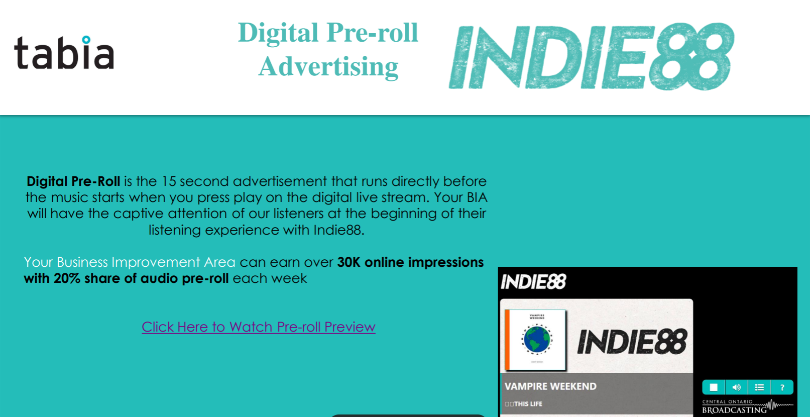

Slide 29

toronto
Access Media Kit: Date Night Toronto Media Kit

Slide 30


Slide 31

West End Pheonix
Access Media Kit: West End Pheonix Media Kit

Slide 32
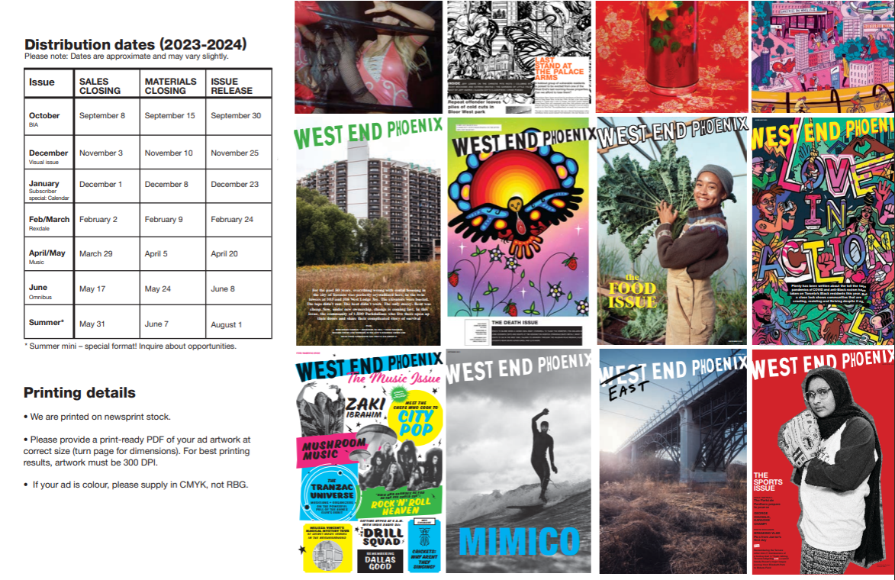

Slide 33

Destination Toronto
Access Media Kit: Destination Toronto Media Kit

Slide 34

Destination Toronto
Rate Card
Home Page Sponsor -$700/month
Premium Page Sponsor -$200/month (Available on Culture & Entertainment, Food & Entertainment)
Run of Site Banner -$550/month
Spotlight Run of Site -$350/month
Mobile Footer -$500/month (Available 1/3/2023)
Social Media Submission Form: Partner Content Submission Form (monday.com)
Newsletter Exclusive Digital Ad Placement - $650/month (photo + content, one ad on newsletter each month)
20% discount on all tactics
*Discount already applied

Slide 35

BlogTO
Download media kit: BlogTO Media kit
*Affected by Bill C-18, please see Disclaimer​

Slide 36

BlogTO
Rate Card
Display Ads | BT PRICE | TABIA Preferred | Impressions | Turnaround
Standard Display | $15 | $13 | Scalable | 24-48 hr | Purchased by Impression
Content Distribution | BT PRICE | TABIA Preferred | Impressions | Turnaround
Branded Editorial | $8,000 | $6,800 | 2500 Reads | 3 Weeks | Guaranteed Reads
Branded Announcement | $5,000 | $4,250 | 2500 Reads | 4-5 Days | Estimated Reads
blogTO Website Contest | $3,250 | $2,700 | 100,000 | 2 Weeks | Estimated Impressions
blogTO Events Newsletter | $1,700 | $1,450 | 80,000 subs | 2-4 Days | Estimated Impressions
blogTO Daily Newsletter | $2,000 | $1,700 | 90,000 subs | 2-4 Days | Estimated Impressions
blogTO eBlast | $500 | $425 | 15,000 subs | 2-4 Days | Estimated Impressions
Video | BT PRICE | TABIA Preferred | Impressions | Turnaround
Instagram Reel | $5,000 | $4,000 | 100,000 | 2 Weeks | Guaranteed Impressions
Reel Extension to Facebook and/or Twitter (blogTO) | $2,000 | $1,700 | 25,000 | 2 Weeks | Estimated Impressions
Reel Extension to blogto.com | $2,500 | $2,125 | 120,000 | 2 Weeks | Guaranteed Impressions
TikTok Video | $5,000 | $4,250 | 55,000 | 2 Weeks | Guaranteed Impressions
Social Media | BT PRICE | TABIA Preferred | Impressions | Turnaround
Instagram Image Post | $2,750 | $2,000 | 100,000 | 3-5 Days | Guaranteed Impressions
Instagram Single Story Slide | $1,000 | $750 | 33,333 | 2-4 Days | Guaranteed Impressions
Facebook Post (1-4 images) | $1,250 | $1,000 | 10,000 | 2-4 Days | Estimated Impressions
Tweet | $1,150 | $975 | 10,000 | 2-4 Days | Estimated Impressions
Contest Management Fee | $500 | $425 | N/a | N/a
Visual Production | BT PRICE | TABIA Preferred | Impressions | Turnaround
Custom Photography | $250 | $200 | N/a | N/a
Section Takeovers / Roadblocks | BT PRICE | TABIA Preferred | Impressions | Turnaround
Homepage (Daily Flat Rate) | $6,000 | $5,100 | 300,000 | 24-48 Hrs | Estimated Impressions
Radar + Events (Daily Flat Rate) | $500 | $425 | 25,000 | 24-48 Hrs | Estimated Impressions
15% discount on all tactics

Slide 37

Now Toronto
Download Media Kit: Now Toronto Media Kit
*Affected by Bill C-18, please see Disclaimer​

Slide 38

Now Toronto Rate Card
Highlight Article (up to 500 wrds) - $1,500
Shared across all social media platforms + newsletter share
1 Mini Video Report (up to 1 minute) - $ 3,500
Shared across all social media platforms + newsletter share
Content Bundle Package (Article + Video Report) - $4,500
Shared across all social media platforms, Story & Swipe Up link and newsletter share
Weekend Roundup - $1,000
1 spot in Now Toronto WeekendRound Up Article (up to 150 words)
1 spot in Now Toronto WeekendRound-up Video Report
1 share in Now Toronto WeekendRound Up Newsletter share
Shared across all social media platforms + newsletter share
*Over 25% discount on all tactics
*All tactics are automatically added to the “Neighbourhood Series”
dedicated webpage on Now Toronto

Slide 39
CityWide Program Overview - Ad Partners
For contracts and invoices, please email or CC monina@toronto-bia.com
Ad Partner | Contact | Email | Rate Card | Media Kits / Templates
Pattison (TTC) | Kai Trudeau | KTrudeau@pattisonoutdoor.com | Pattison Rate Card *Refer to this for accurate rates, disregard rates in Media Kits | Pattison Media Kit - Overview Pattison Media Kit - Detailed Vertical 28 Poster Template 4x6 Poster Template Digital Network Template
Astral Out of Home TTC Bus Shelters | Alida Ianni | Aianni@astral.com | Same as media kit | Astral Bus Shelter Media Kit Astral Out of Home – Bus Shelter Specs Astral Bus Shelter Poster - Template
Astral Media – CHUM FM, Virgin radio, Newstalk, TSN | Lorraine O'Grady | Lorraine.ogrady@bellmedia.ca | Astral Media Radio Rate Card | Astral Media – Radio Media Kits
Indie 88 | Jeremiah Braithwaite | jeremiah@indie88.com | Indie 88 Rate Card | Indie 88 Media Kit
West End Pheonix Newspaper | Mike Mayberry | sales@westendphoenix.com | West End Pheonix Rate Card | West End Pheonix Media Kit
CP24 | Lorraine O'Grady | Lorraine.ogrady@bellmedia.ca | Same as media kit | CP24 Media Kit
BlogTO | Curtis Tomaselli | c.tomaselli@zoomermedia.ca | BlogTO Rate Card | BlogTO Media kit
Curiocity Toronto | Rosie Jones | rosie@curiocity.com | Curiocity Rate card | Curiocity Toronto Media Kit
Date Night Toronto | Selena Kovachis | selena@itsdatenight.com | Date Night Toronto Rate Card | Date Night Toronto Media Kit
Taste Toronto | Cameron Scott | cscott@suite66.com | Taste Toronto Rate Card | Taste Toronto Media Kit
Streets of Toronto | Cameron Scott | cscott@suite66.com | Streets of Toronto Rate Card | Streets of Toronto Media Kit
Destination Toronto | Gail Stewart | Gail.Stewart@Destinationtravelnetwork.com | Destination Toronto Media Kit | Destination Toronto Media Kit
Now Toronto | Chris Johnson | Chris@gonezmedia.com | Same as media kit | Now Toronto Media Kit

Slide 40




2024
Advertising Partners

Slide 41
Bill C-18 Disclaimer
Affected Ad Partners: BlogTO & Now Toronto
Ad partners affected by Bill C-18, The Online News Act, have guaranteed TABIA that they are not blocked by Meta from boosting posts. Using the boosting post strategy, they can achieve the impressions provided in their respective media kits.
This information was updated and provided after the passing of Bill C-18.
Learn more about Bill C-18, The Online News Act

Slide 42
Thank you
Please forward CityWide Program requests and inquiries to
monina@toronto-bia.com

